Slide 1







Spacecraft Anomaly Resolution Knowledgebase
SPARK
Creating a centralized anomaly database
Application to NASA SOARS Radiation Anomalies
SCAF
27 March 2024
SBIR DATA RIGHTS
Contract#: 80NSSC23PB503
NextGen Federal Systems
1399 Stewartstown Road, Suite 350
Morgantown, WV 26505
Award Date: 8/3/2023
Expiration Date: 8/2/2043

Slide 2
Agenda
NextGen Overview
Relevance, Opportunities, and Challenges
Technical Approach
Work Executed
Demo
Discussion
This page is protected by and subject to the SBIR Data Rights legend set forth on the title page

Slide 3
NextGen Overview
3
This page is protected by and subject to the SBIR Data Rights legend set forth on the title page

Slide 4

Who We Are & What We Do
NextGen Federal Systems (NextGen) is a HUBZone certified small business with a track record for providing Innovative Solutions and Services for Defense C4ISR
Contract Vehicles:
Advanced Battle Management Systems (ABMS) – USAF
Advanced Technical Exploitation Program (ATEP) – NASIC
Engineering & Operations Support – Army CECOM SEC
Facility Management, Logistics, Administration, Readiness, Engagement, and Security (FLARES) IDIQ – DIA
GSA One Acquisition Solution for Integrated Services (OASIS)
  GSA OASIS SB Pool 1 (541611)
  GSA OASIS SB Pool 3 (541330)
GSA MAS Schedule (SIN 54151S)
Responsive Strategic Sourcing (RS3) IDIQ – Army C5ISR
SBA HUBZone Program (FAR Subpart 19.13)
SBIR Phase III USAF
Services
  Software Development
  Systems Engineering
  Cybersecurity
  Test & Evaluation
  Program Operations
Solutions
  Mission Planning
  Situational Awareness
  Multi-Domain Data Fusion
  Architecture Modernization
  C2 Decision Aids
  Virtual & Augmented Reality
Research & Development
  Weather Impact Analysis
  Autonomous / Swarming Drones
  Sensor Planning
  Artificial Intelligence
  Machine Learning
  Space Weather Forecasting
  Soil Moisture Analysis

Slide 5
Relevance, Challenges, Opportunities
5
This page is protected by and subject to the SBIR Data Rights legend set forth on the title page

Slide 6
Relevance
U.S. National Space Policy 2020: “Develop, maintain, and use SSA information from commercial, civil, and national security sources in an open architecture data repository to detect, identify, and attribute actions in space that are inconsistent with the safety, stability, security, and the long-term sustainability of space activities.”
Operations – anomaly resolution can be used to provide feedback to space system design and parts selection/qualification in addition to helping develop efficient and effective operational work arounds or patches.
Science/Engineering – anomaly resolution can corroborate and validate mission vulnerability, system/parts failure, and space environmental models.
Political – anomaly resolution can contribute insights to geo-political discussions about disruption of space system operations which might prevent unnecessary and escalatory actions.
Fiscal – Unambiguous identification of the cause for anomalies and failures can provide valuable input for insurance processing.

Slide 7
Opportunities and Challenges
A centralized and standardized satellite anomaly database is recognized by subject matter experts from the organizations we contacted—including the national oceanic and Atmospheric Administration (NOAA), the Aerospace Corporation, and commercial companies—as a potentially valuable resource for the satellite operator community.
  Aid in anomaly investigations
  Reduce costs and increasing efficiency
  Contribute to the scientific understanding of the real-world impacts of the near-Earth space environment (think functionality – next slide)
The development of a centralized satellite anomaly database that would be useful to the broad satellite community is hindered by concerns about sharing proprietary information and by a lack of dedicated resources for development and maintenance.
  Concerns over sharing of proprietary information are perhaps the most significant obstacle for companies in the commercial sector.
  Lack of resources for development and maintenance is a problem in the civil and defense sectors of government, which would likely include organizations that could serve as trusted third parties or those that could develop the encryption technologies that could help address the privacy concerns associated with sharing anomaly data.
Management of a centralized database by a trusted third party, encryption techniques such as secure multiparty computing, and differential privacy may help overcome inhibitions of commercial satellite operators to share anomaly information, thus contributing to greater benefit throughout the satellite operator community.
  Authorize a trusted third party to ingest and manage the data provided by contributing satellite operators; to categorize the anomalies; and to reveal information only in aggregate, statistical form to avoid divulging proprietary identifying information from the contributors.
- RAND 2014 Study

Slide 8
“How?” Framed in Information Technology (IT)
Trust and Privacy: Incorporate and protect sensitive data in a trusted database; Control user access to the database, to include data filtering and anonymization
Stewardship: If an aggregate database of anomalies were created, who would store and maintain it?
Cybersecurity: Who is willing to assume the security responsibilities that are associated with a user’s trust?
Longevity: How will the software and infrastructure of the product be maintained and commercialized to lower the risk of use and adoption?
Functionality: What are the benefits beyond simply having a centralized anomaly database? How does it support anomaly resolution via analysis and modeling?

Slide 9
Technical Approach
Alec Engell

Slide 10
SPARK Addresses the Challenges and Opportunities
The developers of SPARK at NextGen are experts in the implementation and operation of DoD and Intel Community information systems; Core areas of expertise include
  Cyber Security and Information Assurance
  Data Engineering and Data Management
  Enterprise IT Systems Engineering
  Research and Development including space weather ML forecasting
SPARK is a cyber-secure software stack built on well-supported open-source software (OSS)
Extends the Space Radiation Intelligence System (SPRINTS) database and software
  Cloud-optimized database that is extensible to other space weather and satellite data sources
    Space weather data and events with APIs from 1986 – near real-time
  State-of-the-art OSS dashboards for operations and research
    Data visualization, annotation, upload/download, and analysis
  A cloud-based environment with ML and data-driven analysis and modeling workflows
    Data-discoverability, pattern recognition, and event/time-series predictions

Slide 11
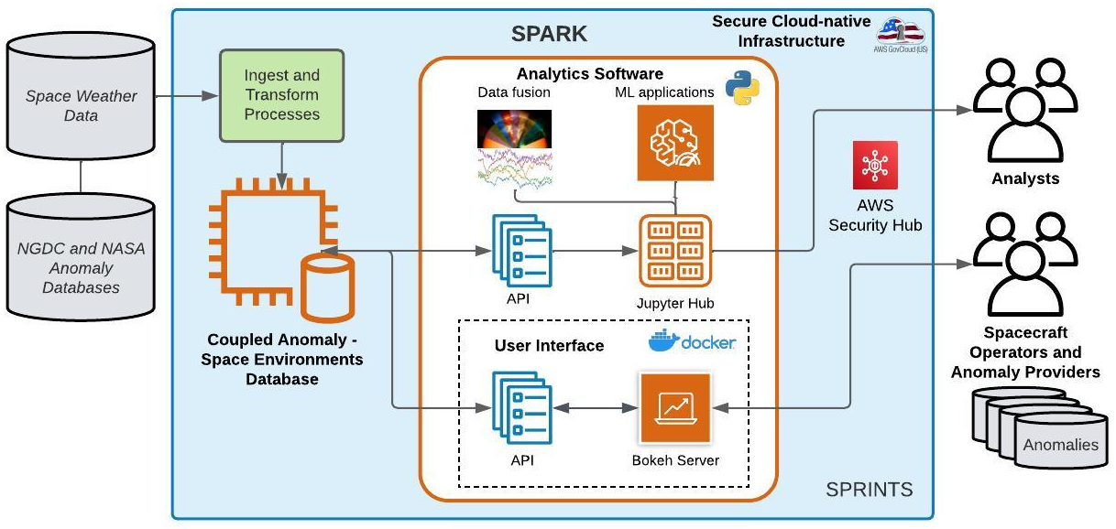
SPARK Notional Architecture

Slide 12
SPARK and SOARS
Alec Engell
This page is protected by and subject to the SBIR Data Rights legend set forth on the title page

Slide 13
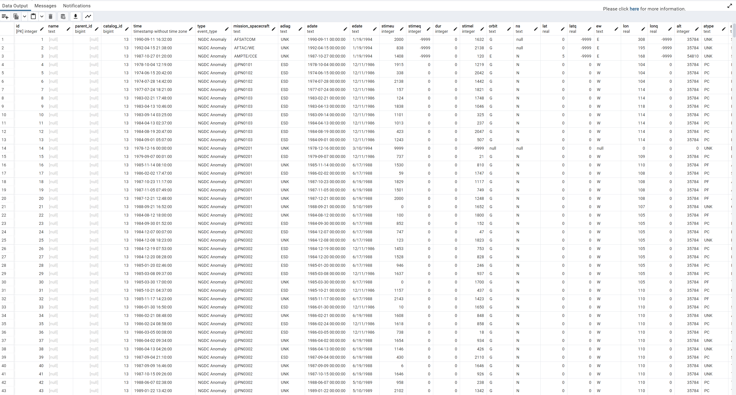
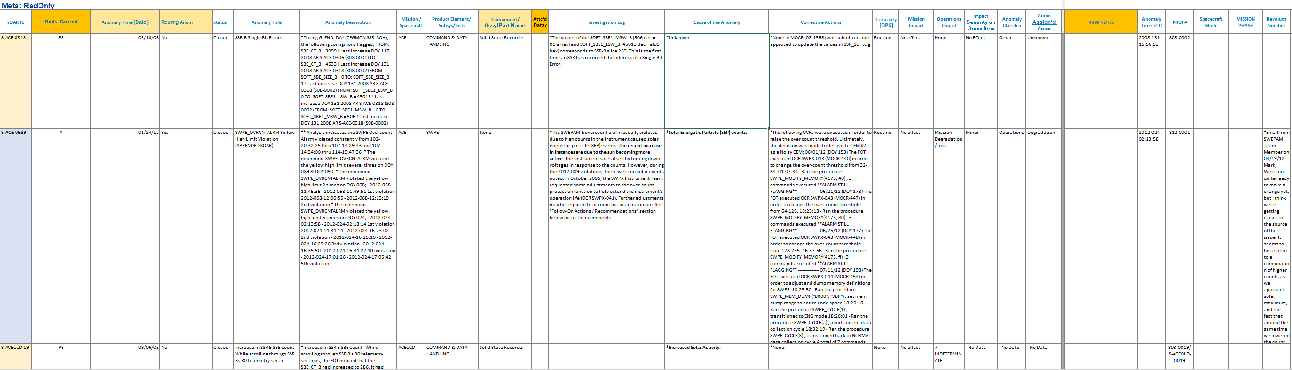
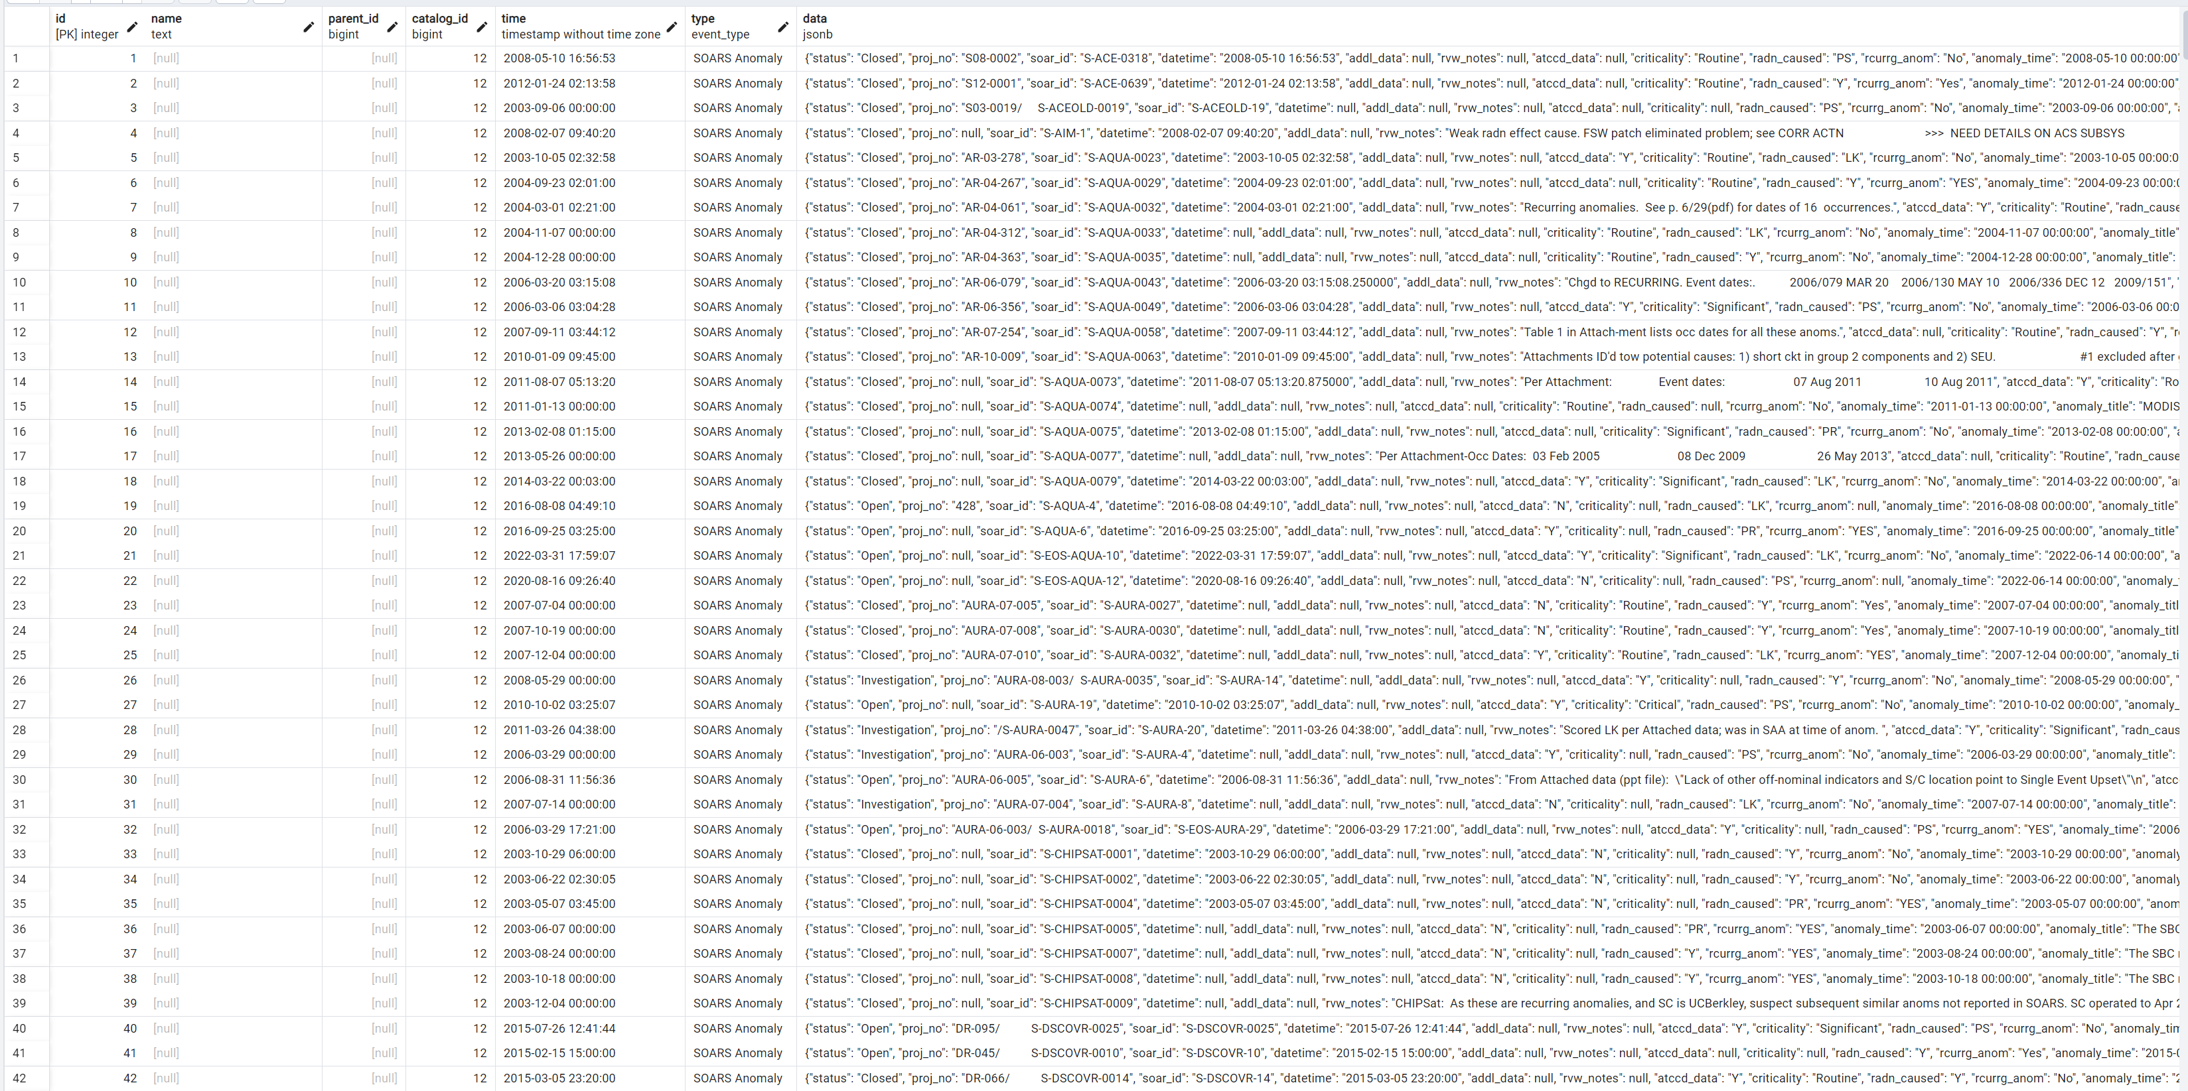
Anomaly Databasing
Developed three (3) anomaly catalogs in the database
  NASA SOARS
    Preprocessing: datetime and anomaly extraction
  NOAA/NGDC
  Universal (combines SOARS and NGDC)
“Universal” Catalog
SOARS Curated Anomaly Datatable
(courtesy of NASA GSFC)
SOARS Curated Anomaly Catalog
NOAA/NGDC Catalog
This page is protected by and subject to the SBIR Data Rights legend set forth on the title page

Slide 14
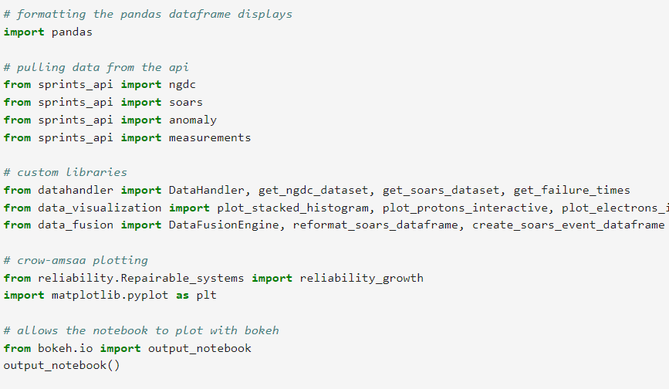
Anomaly Databasing
Developed three (3) corresponding APIs
Supporting libraries for data fusion and analysis
This page is protected by and subject to the SBIR Data Rights legend set forth on the title page

Slide 15
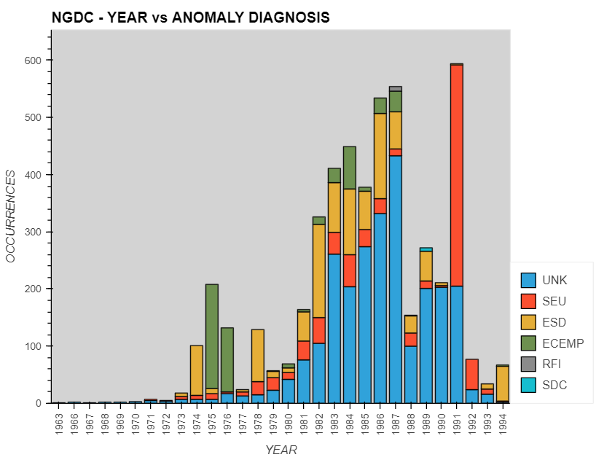
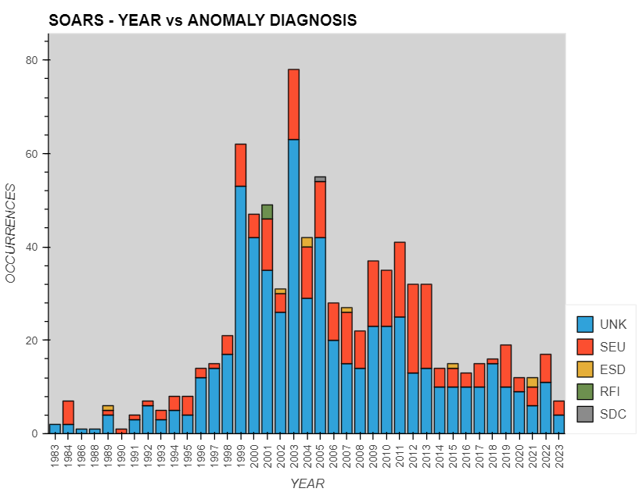
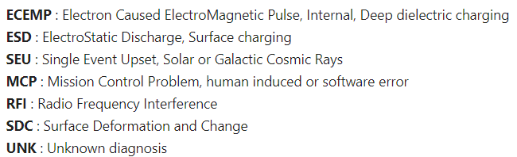
Anomaly Database Summaries (Year v. Diagnosis)
This page is protected by and subject to the SBIR Data Rights legend set forth on the title page

Slide 16
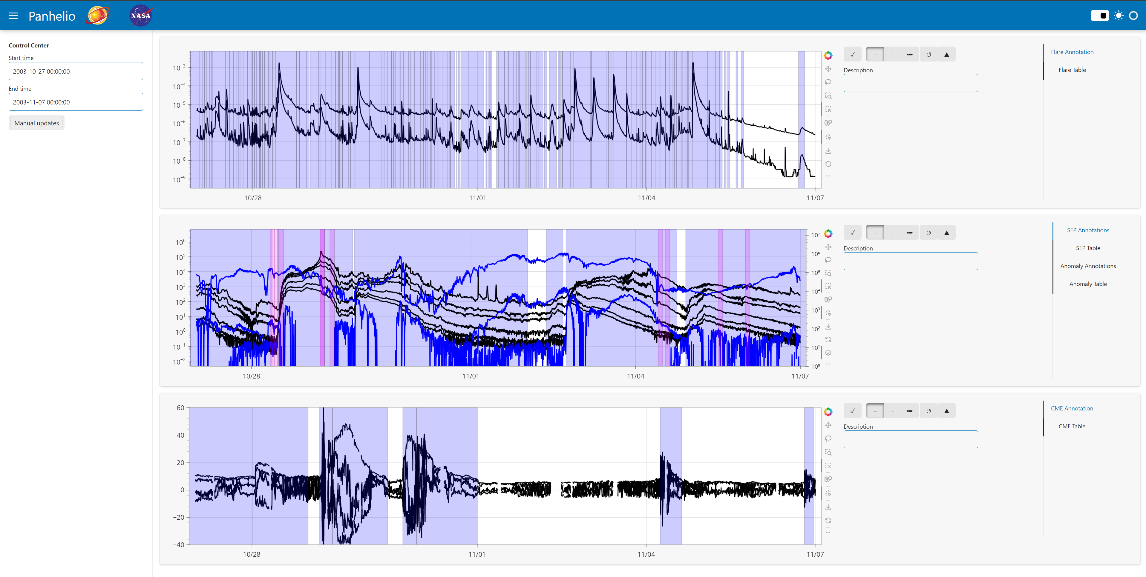
Anomaly-Environment Dashboard (10/27/2003)
This page is protected by and subject to the SBIR Data Rights legend set forth on the title page

Slide 17
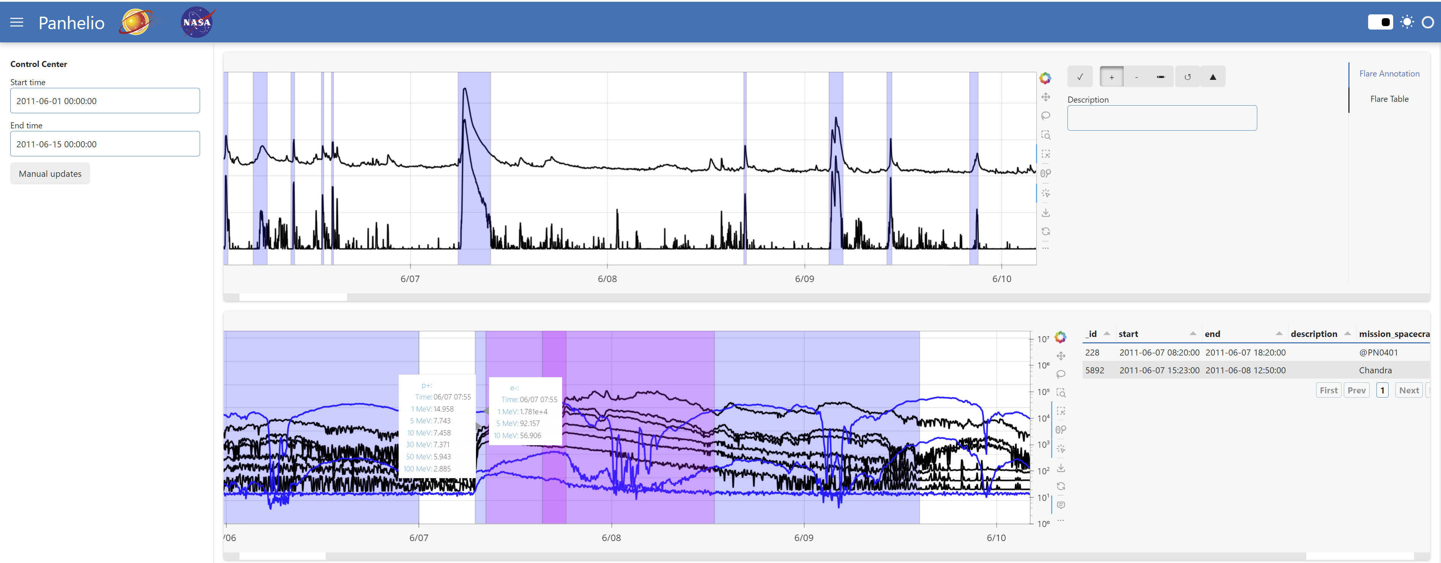
Chandra Radiation Intervention - Auto HRC (Hard)

Slide 18
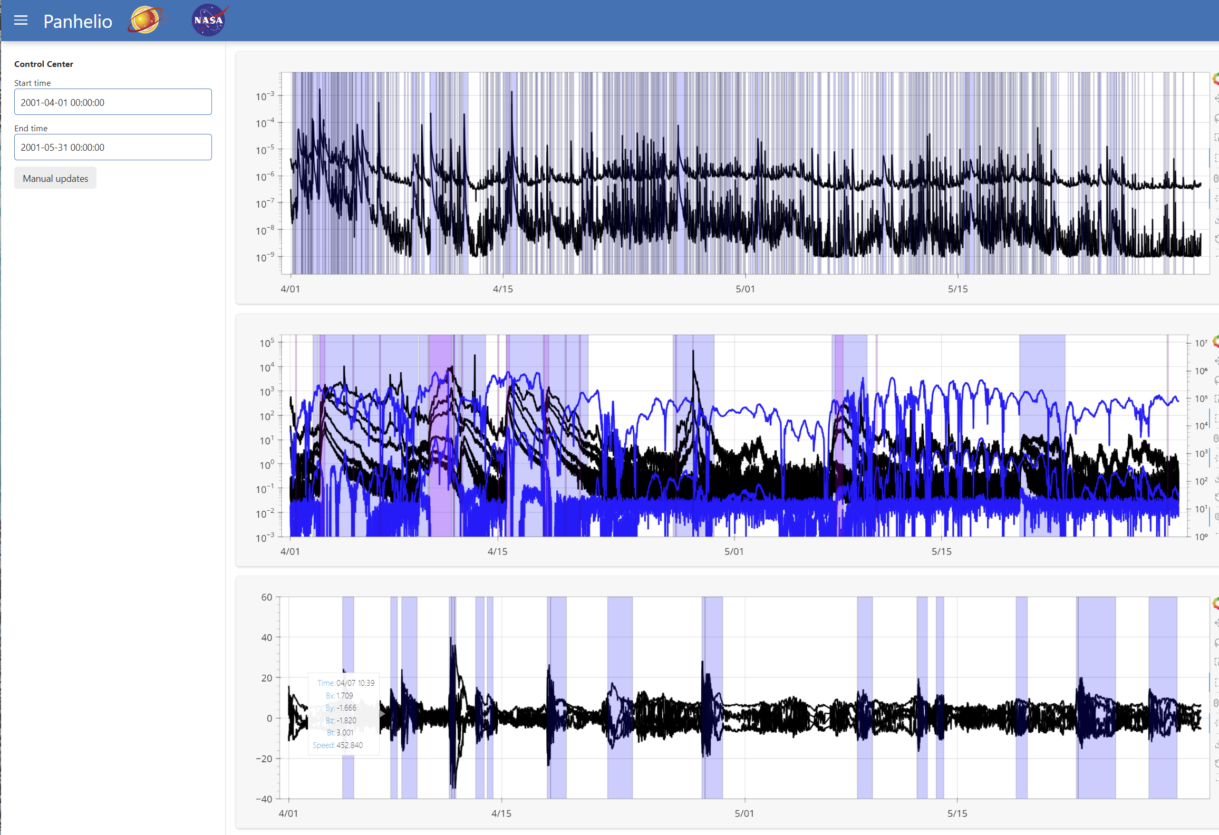
April 1 – May 30, 2001

Slide 19
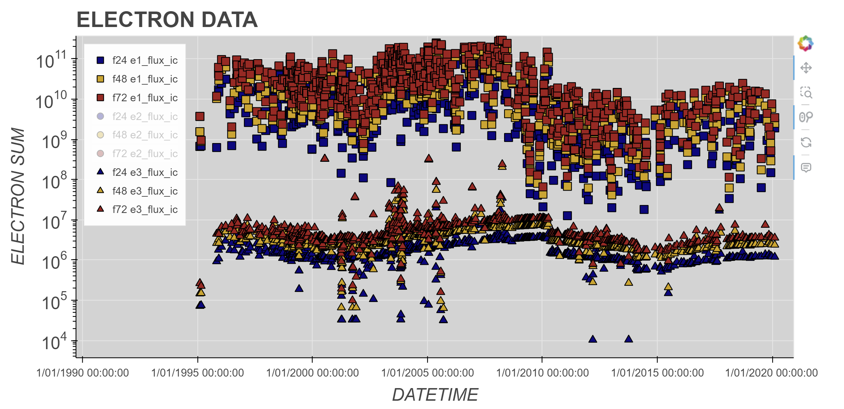
Anomaly-Environment Fusion Examples
GOES protons
  SEU NGDC/SOARS events
  Peak and 24-hour fluence leading to event
GOES electrons
  ESD NGDC/SOARS events
  24, 48, 72-hour fluence leading to event
ACE/DSCOVR solar wind
  All events
  24, 48, 72-hour leading to event
    Max Bz in the time-period
    Sum Bt and solar wind speed in the time-period
This page is protected by and subject to the SBIR Data Rights legend set forth on the title page

Slide 20
Demo Videos

Slide 21
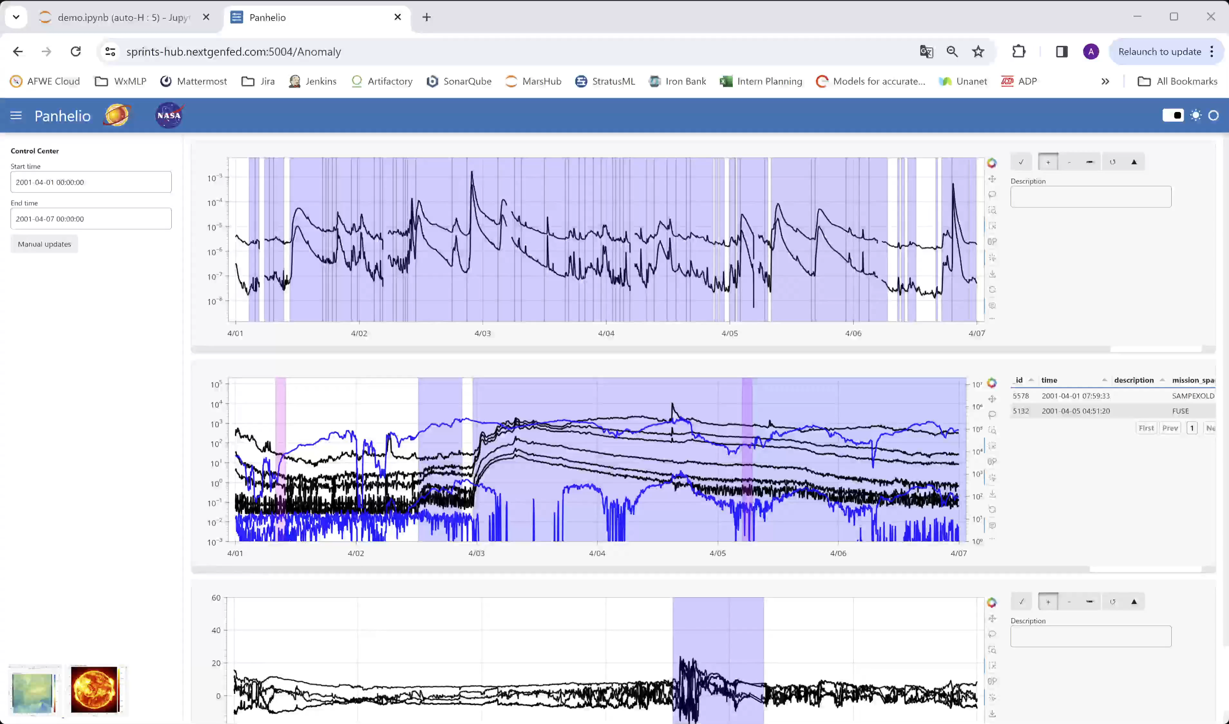

Slide 22
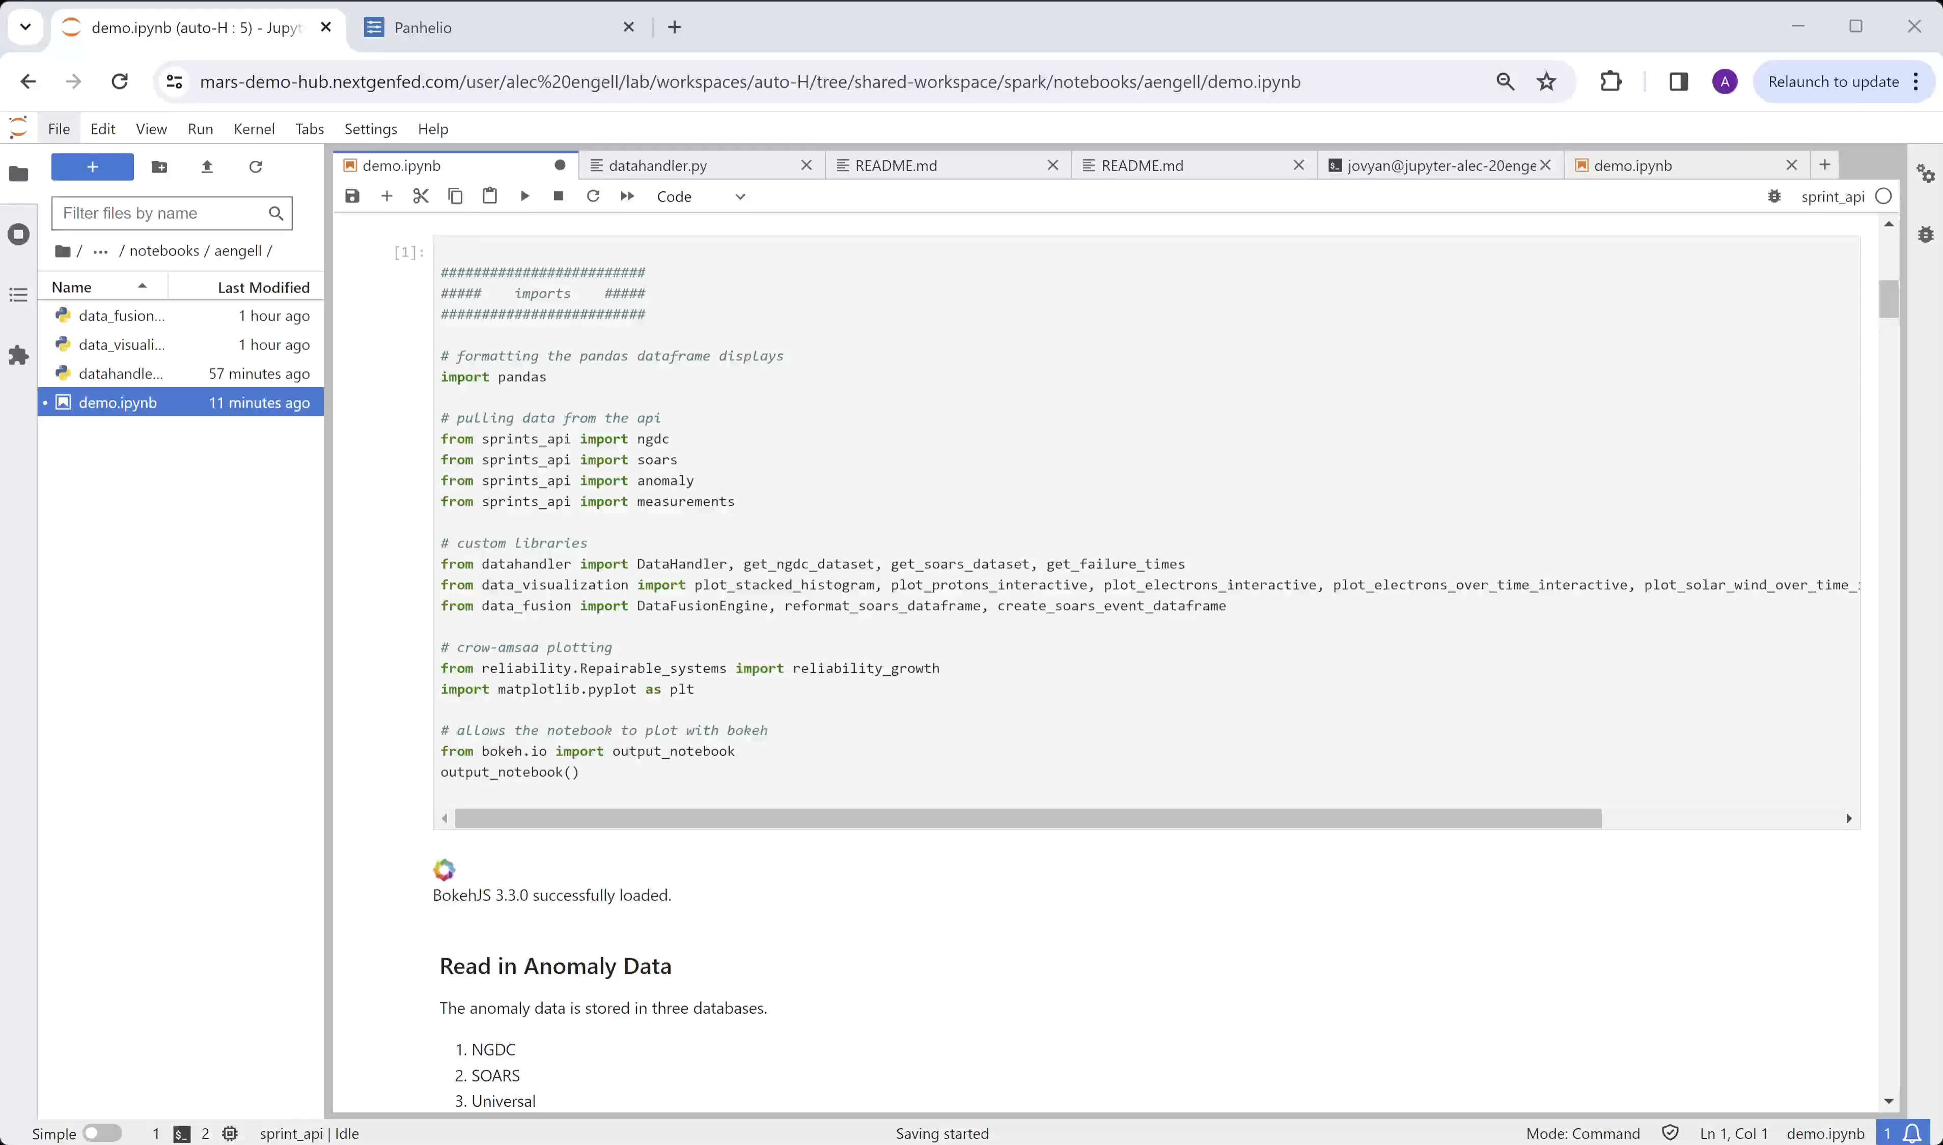

Slide 23
Discussion
All
This page is protected by and subject to the SBIR Data Rights legend set forth on the title page

Slide 24
Topics
Feedback
  Additional functionality requests/ideas?
  Will help improve solution!
Extensible
  Connect with existing anomaly resolution tools
SPARK prototype dashboard will be open and live in July
This page is protected by and subject to the SBIR Data Rights legend set forth on the title page

Slide 25
Contact Information
Program Manager: Daryl Everding
  deverding@nextgenfed.com
  Cell: 513.392.1228
Tech Lead: Alec Engell
  aengell@nextgenfed.com
  Cell: 978.621.5880
VP Engineering: Jeremy Loomis
  jloomis@nextgenfed.com
COO: Chetan Desai
  cdesai@nextgenfed.com
This page is protected by and subject to the SBIR Data Rights legend set forth on the title page

Slide 26
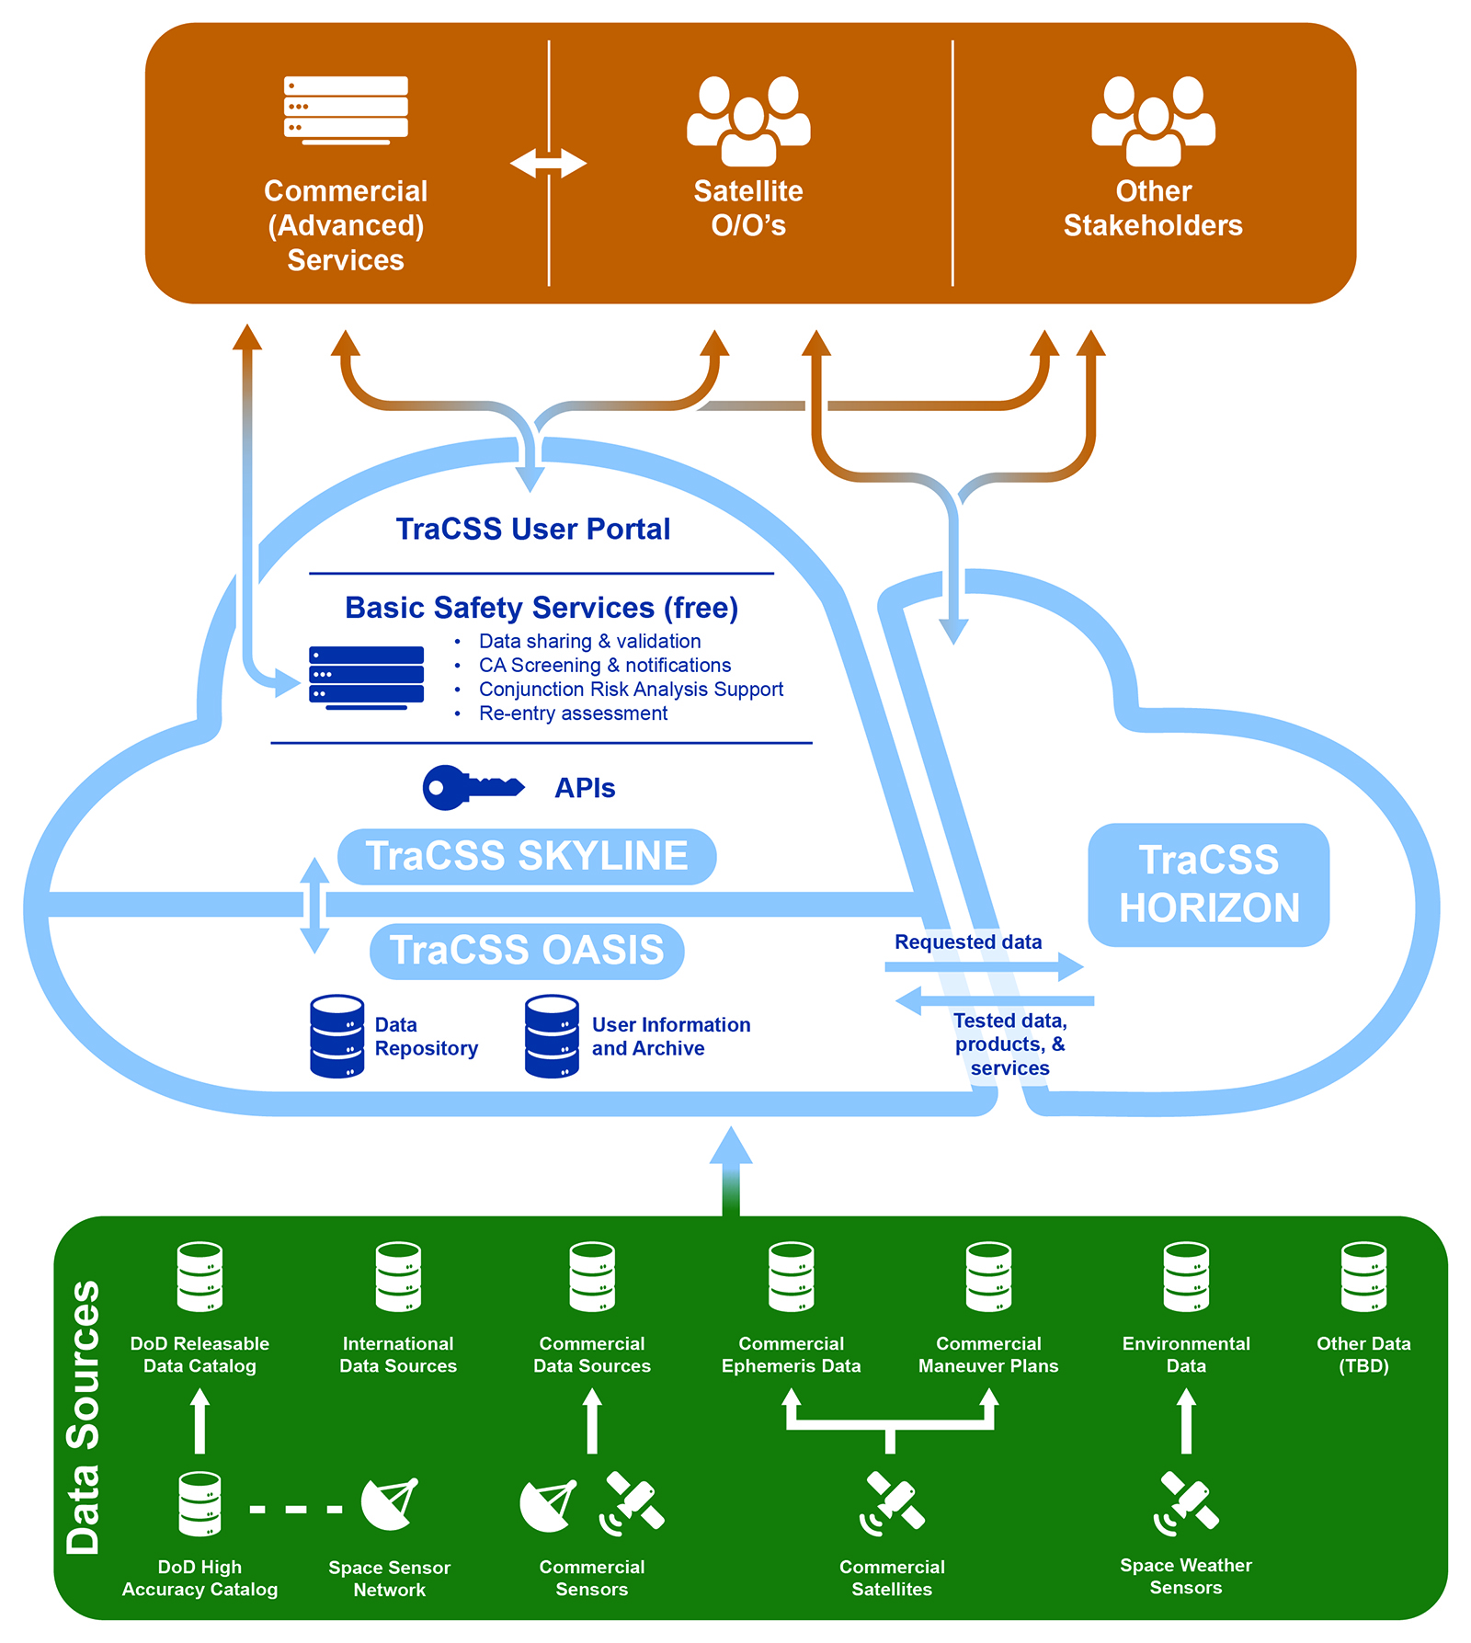
Backup - TRACCS
NOAA’s Office of Space Commerce (OSC) is developing the Traffic Coordination System for Space (TRACSS) to provide basic space situational awareness (SSA) data and services to civil and private space operators and to support spaceflight safety, space sustainability, and international coordination.

Slide 27
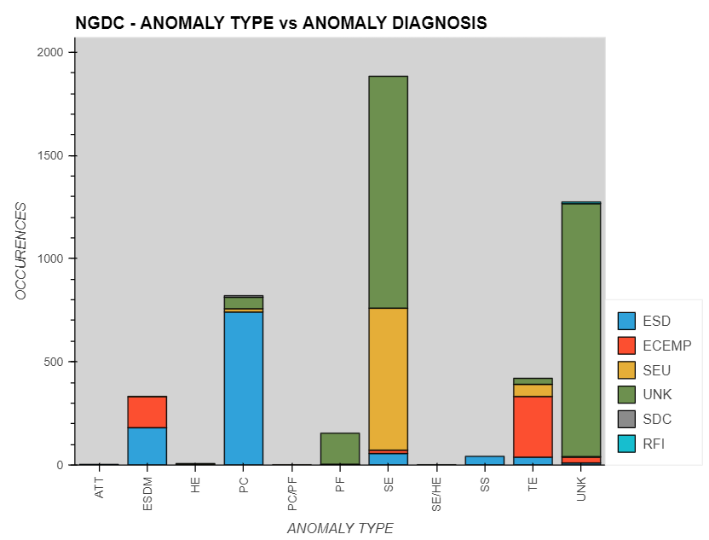
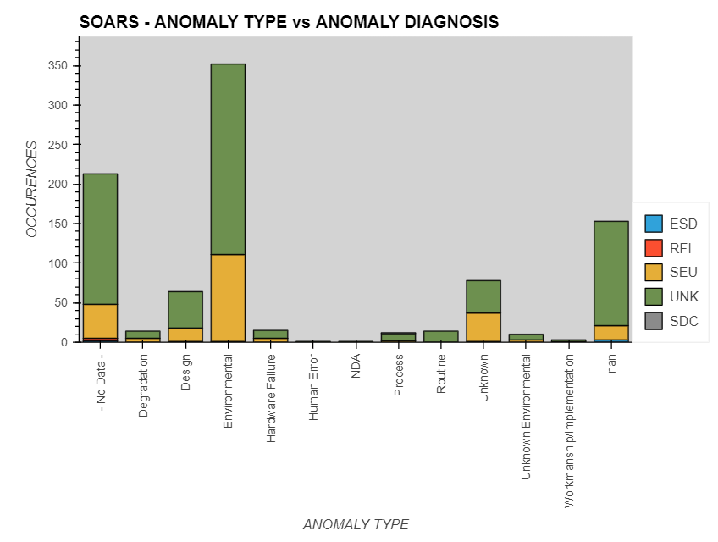
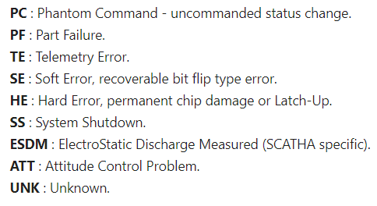
Anomaly Database Summaries (Type v. Diagnosis)
This page is protected by and subject to the SBIR Data Rights legend set forth on the title page

