Slide 2
Housekeeping
If you have any questions during the presentation, please enter them into the Q&A box. We will do our best to answer them in the order in which they are received.
Other comments, like technical difficulties, please visit the Help Desk in the lobby of the virtual environment.
Ensure a stable connection, we highly recommend that you utilize Google Chrome for the best attendee experience. In addition, close unnecessary applications and browser tabs to optimize your computer's performance.
Today’s presentation WILL be recorded. Attendees will receive an email once those materials (PPT and recording) are made available online.
We will have a series of five (5) poll questions. When that time permits, please take the time to fill out the poll questions accordingly.

Slide 3
Housekeeping Cont.
Please fill out the post-event survey that will be sent to your email, via Eventbrite, at the conclusion of today’s event.
In the main event space, located at the top left of the control bar, there should be an icon that looks like a briefcase. When you click on it, there are preloaded materials. As you go through today’s virtual exhibit booths, you can click on all the information and add it to your briefcase, so when you’re ready you can view or download the content now or at a later time.
In the lobby, you will see a “Public Group Chat” button. You can use this chat to network or share information about your business with fellow attendees. If you have a question about the virtual environment, please use the event's Help Desk, accessible via the menu bar at the top of your screen.
Engage with us on social media during today’s event (“X”: @NASA_OSBP and Facebook: @NASASmallBusiness) and share your thoughts, experiences, & key takeaways!

Slide 4
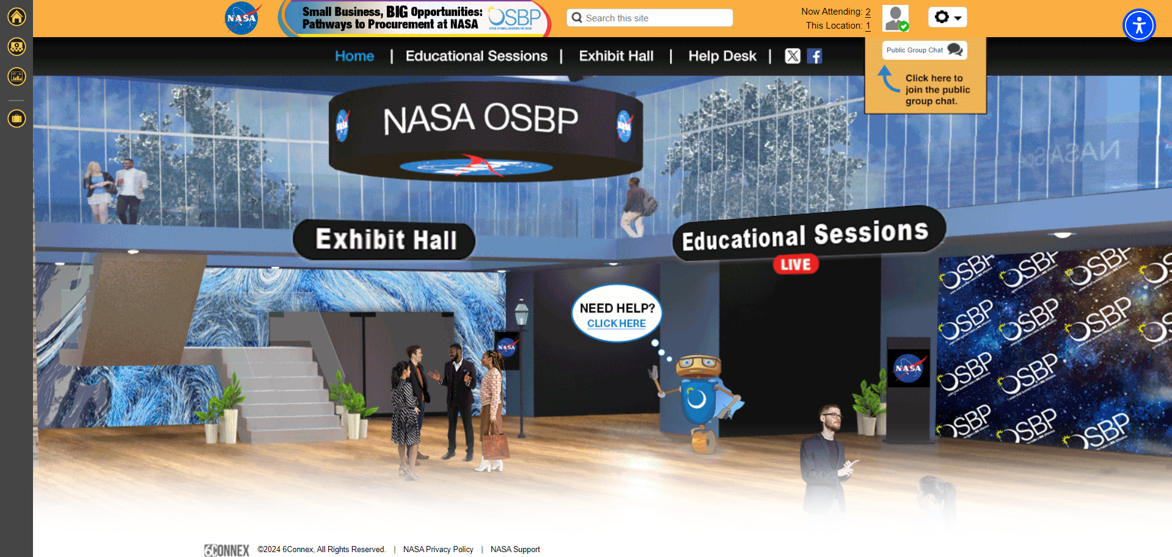
4

Slide 5
Poll Questions
1. How did you learn about this webinar?
  OSBP Website
  Constant Contact
  Social Media
  Eventbrite email
  Other
2. Is this the first webinar hosted by the NASA Office of Small Business Programs that you have attended?
  Yes
  No

Slide 6
Poll Questions Cont.
Which of the following classifications applies to your institution/organization/company?
    Small Business (SB)
    Small Disadvantage Business (SDB)
    Large Business (LB)/Other than Small Business (OTS)
    Women-Owned Small Business (WOSB)
    Economically Disadvantaged Women-Owned Small Business (EDWOSB)
    Veteran-Owned Small Business (VOSB)
    Service-Disabled Veteran-Owned Small Business (SDVOSB)
    Historically Underutilized Business Zone (HUBZone)
    8(a) Business Development Program Participant (8a)
    Historically Black Colleges or Universities (HBCU)
    Minority-Serving Institution (MSI)
    Nonprofit or Community-based Organization
    Federal Government Agency/Department
    State or Local Government Agency/Department
    Other

Slide 7
Poll Questions Cont.
4. Have you done business with NASA? (More than one answer can be applicable)
  Prime Contractor
  Subcontractor
  NASA Mentor-Protégé Program
  Space Act Agreement
  Grant or Cooperative Agreement Recipient
  I have not done business with or received funding from NASA
5. What are some of the barriers to entry when doing business with NASA?
  {Text Responses}

Slide 8
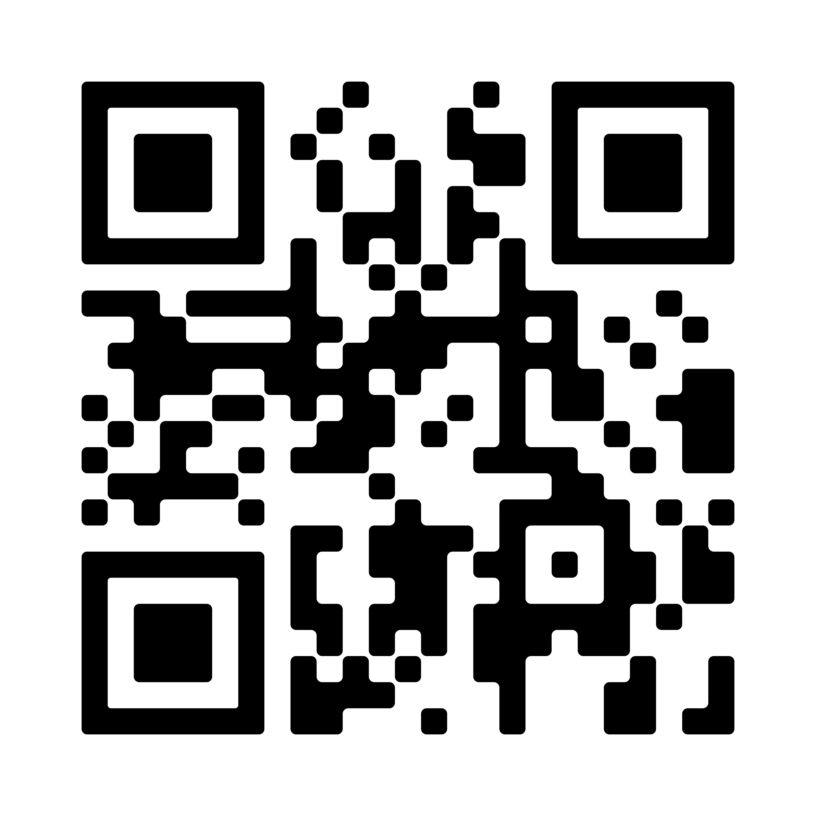
Welcome from OSBP
Mr. Robert Medina
Acting Associate
Administrator
NASA Office of Small
Business Programs

Slide 9
How to Do Business with NASA – New Entrant
Ms. Jennifer D. Perez
Lead Business Specialist
NASA Goddard Space Flight Center

Slide 10
“How to Do Business with NASA – New Entrant”
Jennifer D. Perez
Lead Small Business Specialist

Slide 11
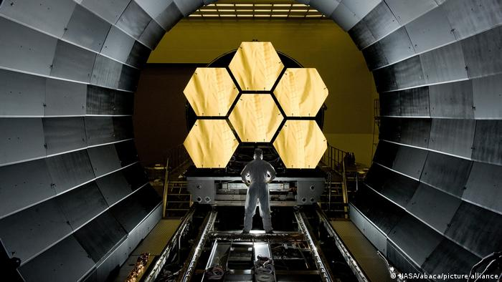
Our Mission
  The mission of the NASA Office of Small Business Programs is to promote and integrate small businesses into the industrial base of contractors and subcontractors that support the future of space exploration, scientific discovery, and aeronautics research.

Slide 12
Office of Small Business Programs
HQ Organizational Chart
Robert Medina
Acting Associate Administrator
Richard L. Mann
Program Manager
Charles T. Williams
Program Manager
E. Ann Haase
Program Manager
Truphelia M. Parker
Program Specialist
Naeemah A. Lee
Program Specialist
Briana L. Goins
Program Specialist
Intern(s)
Tracy L. Hudspeth
Communications Specialist (Contractor)
Josezakia K. Byrd
Administrative Assistant
(Contractor)

Slide 13
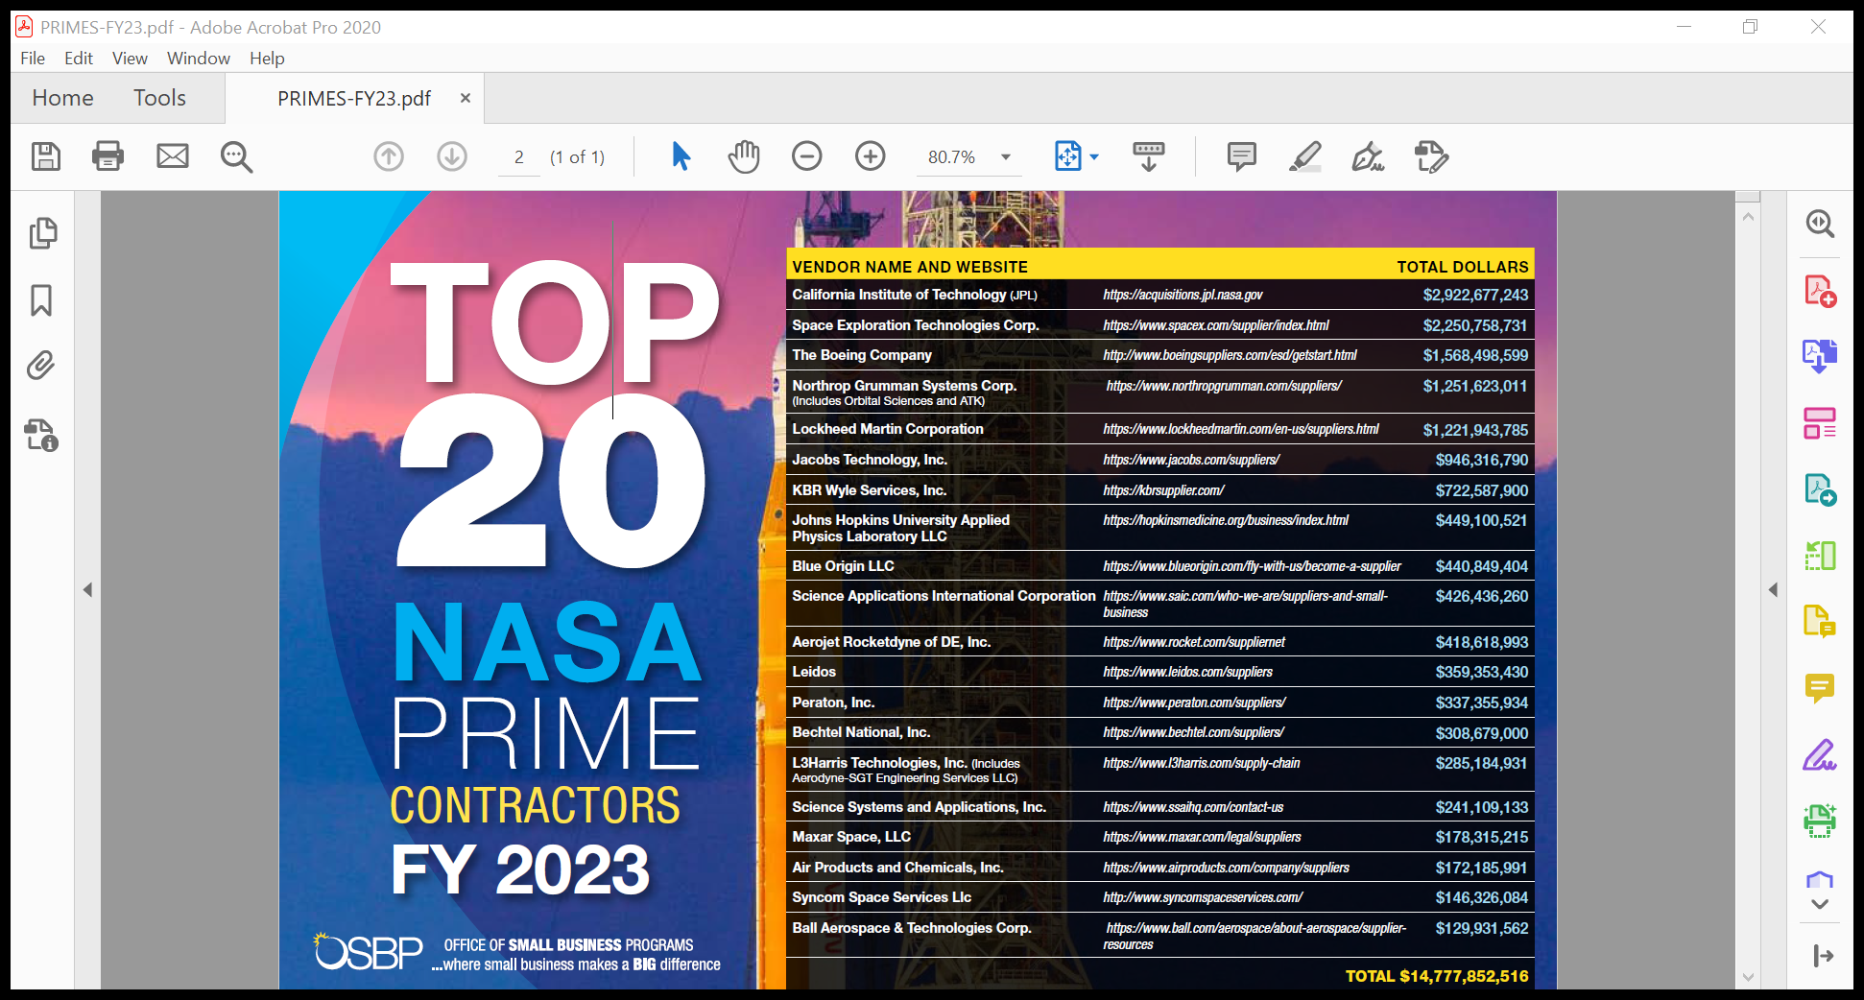
FY 2023 Prime

Slide 14
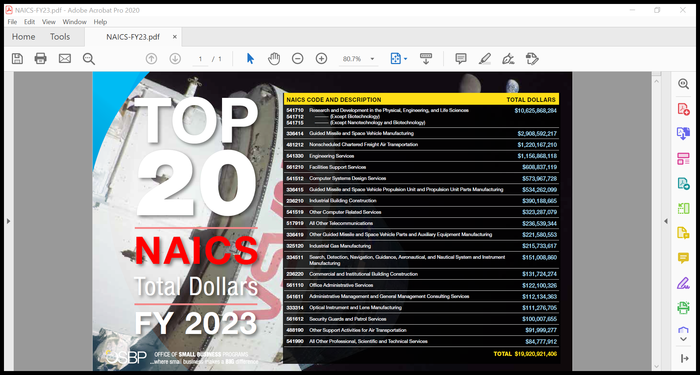

Slide 15
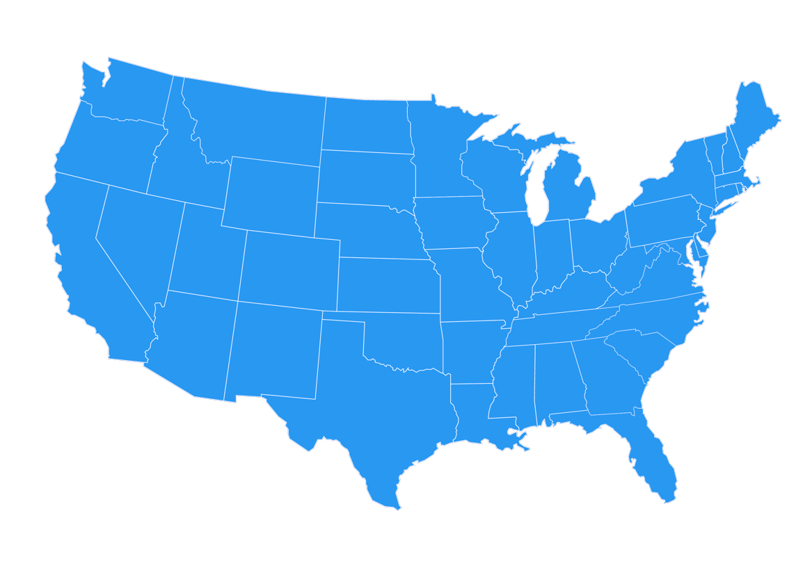



















NASA Small Business Specialists Around the Country
Ames Research Center
Aerospace and Small Spacecraft
Moffett Field, CA
Armstrong Flight Research Center
Atmospheric Research and Testing
Edwards, CA
Christine L. Munroe
Glenn Research Center
Aeronautics and
Spacecraft Technology
Cleveland, OH
Eunice J. Adams-Sipp
Goddard Space Flight Center
Science Missions and Telescopes
Greenbelt, MD
Jennifer D. Perez
Kandace P. Chappell
Djaataa Onanuga
Jet Propulsion Laboratory
Deep Space Robotic Rovers
and Networks
Pasadena, CA
Charles E. Bray, Jr.
Mary Helen Ruiz
Matthew B. Christian
Tara A. Every
Anna N. Hovano
Langley Research Center
Aviation and Space Research
Hampton, VA
Robert O. Betts
Johnson Space Center
Human Space Flight Operations
Houston, TX
NASA Shared Services Center
Agency Contract Support
Bay St. Louis, MS
Troy E. Miller
Stennis Space Center
Vehicle Engine Testing
Bay St. Louis, MS
Kay S. Doane
Kennedy Space Center
Space Vehicle Launch and Landing
Cape Canaveral, FL
Joyce C. McDowell
Natalie B. Colvin
.
Robert E. Watts
Monica F. Craft
Tumarrow Romain
Marshall Space Flight Center
Space Transportation, Propulsion Systems, Space Systems, and Science
Huntsville, AL
David E. Brock

Slide 16
NASA Agency October - September FY23
Prime Goals vs. Actual Percentages
Data generated October 17, 2023 from SAM.GOV

Slide 17
NASA FY 22 Subcontracting Goals vs. Actual Percentages
Data pulled March 16, 2023 from eSRS

Slide 18
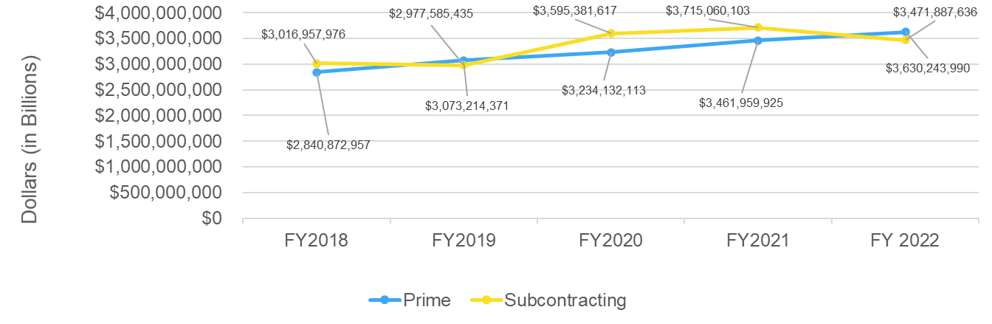
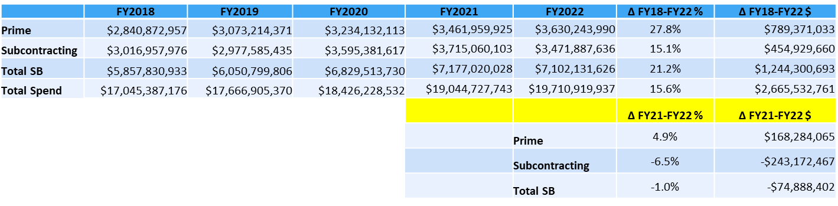
FY18-FY22 OSBP Prime and Subcontracting Dollars Trend

Slide 19

NASA Vendor Database
The NASA Vendor Database (NVDB) is open to all vendors, both large and small, who wish to do business with the National Aeronautics and Space Administration.
  Build a company profile
  Conduct vendor search
  Increase company visibility at NASA!
For more information, visit: https://www.nasa.gov/osbp/nasa-vendor-database
This Photo by Unknown Author is licensed under CC BY-NC

Slide 20
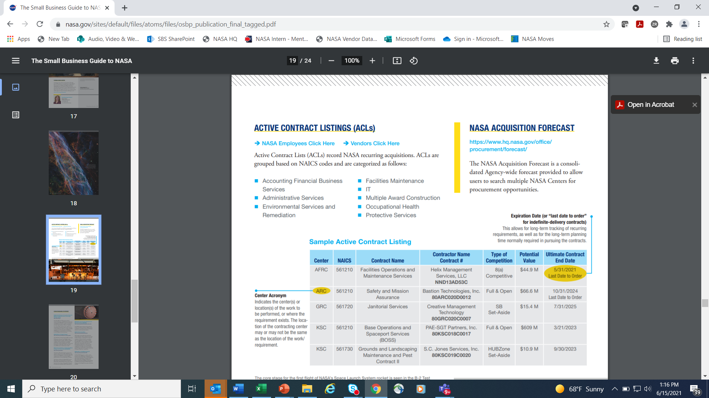
NASA Active Contract Listings
To view: https://www.nasa.gov/osbp/active-contract-listings

Slide 21

OSBP Mobile App
Are you a small business looking to make a big difference? Whether you own an engineering company, develop new telemetry software algorithms, or provide Information Technology services, the NASA Office of Small Business Programs (OSBP) can help you make that difference at the Agency by providing the necessary tools right at your fingertips.
OSBP Mobile is designed to help:
  Provide active contract listings and requests for proposals
  Network with Small Business Specialists at each NASA Center
  Explore the latest Agency prime metrics data
  Inform you of the latest small business news and events.
Come make a BIG difference at NASA!
Download at:
https://play.google.com/
https://apps.apple.com/

Slide 22

Build a Relationship with Prime Contractors through the NASA Mentor-Protégé Program (MPP)
The NASA MPP encourages NASA prime contractors to assist eligible Protégés, thereby enhancing the Protégés’ capabilities to perform on NASA contracts and subcontracts, fostering the establishment of long-term business relationships between these entities and NASA prime contractors, and increasing the overall number of these entities that receive NASA contract and subcontract awards.

Slide 23
NASA Mentor-Protégé Program
The NASA MPP encourages NASA prime contractors to assist eligible Protégés, thereby enhancing the Protégés’ capabilities to perform on NASA contracts and subcontracts, fostering the establishment of long-term business relationships between these entities and NASA prime contractors, and increasing the overall number of these entities that receive NASA contract and subcontract awards.
Webpage: https://www.nasa.gov/osbp/mentor-protege-program
E-mail Address MSFC-NASAMentorProtegeProgram@mail.nasa.gov
Approved Mentors (as of Jan 2023)
a.i. Solutions, Inc.
AECOM
Amentum Services, Inc. (New Mentor)
Bastion Technologies, Inc. (New Mentor)
Bechtel National, Inc. (New Mentor)
Blue Origin (New Mentor)
CACI, Inc. – Federal (New Mentor)
CH2M Hill, Inc. (New Mentor)
Deloitte & Touche, LLP (New Mentor)
Enterprise Services, LLC
General Dynamics Information Technology, Inc. [GDIT] (New Mentor)
Honeywell International, Inc. (Aerospace-Glendale)
Jacobs Technology, Inc
Jones Edmunds & Associates, Inc. (New Mentor)
Leidos Innovations Corporation
LJT & Associates, Inc.
Lockheed Martin
Northrop Grumman
PAE Applied Technologies, LLC
Peraton, Inc. (New Mentor)
Raytheon Company
REI Systems, Inc. (New Mentor)
Science Applications International Corporation (SAIC)
Sierra Lobo, Inc.
Southwest Research Institute
Teledyne Brown Engineering, Inc.
The Boeing Company
Wyle Laboratories, Inc. d/b/a KBRWyle

Slide 24
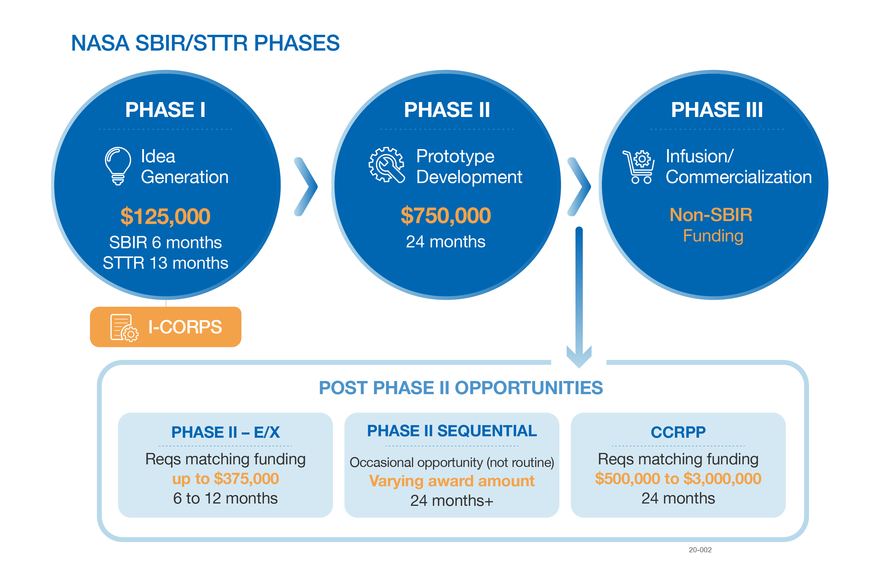
NASA SBIR/STTR
https://sbir.nasa.gov/
Small Business Innovation Research (SBIR)
  A set-aside program for small business concerns to engage in Federal R&D with potential for commercialization
  Currently, 3.2% of Federal agencies’ extramural R&D budgets >$100M per year
Small Business Technology Transfer (STTR)
  A sister set-aside program to facilitate cooperative R&D between small business concerns and U.S. research institutions with potential for commercialization
  Currently, 0.45% of the extramural research budget for all agencies with a budget >$1B per year
Notes:
…a look at exactly what our program offers to small businesses like yours—or what we call the “phases” of the NASA SBIR/STTR program.
We find and fund our small businesses through “Phases”, as shown on the screen right now. I won’t go over every detail of each one, but at a high level:
Phase I is what we like to call the “idea phase”;
Phase II is focused on the actual development, demonstration, and delivery of the innovation; and
Phase III is where the small businesses’ innovative technologies, products, or services make their way into NASA missions and/or the commercial marketplace;
But, to put it plainly, getting to a successful Phase III is tough. Phase I and II awards alone are not typically enough to support a company’s journey to commercialization. So, our Program has created additional opportunities to help firms get there—and with more than just funding—through initiatives like the I-Corps program and our various post-Phase II vehicles.
I-Corps provides business assistance and training to our firms that, in turn, help them develop better products and grow.
Additionally, our post-Phase II vehicles are important mechanisms for our program to be able to support small businesses as they transition their technologies—readying them for either commercialization into the marketplace or infusion into a NASA mission. For example, last summer, you may have seen that NASA announced $29 million in awards through our Phase II Sequential awards. This money was given to just seven of our Program’s small businesses in order accelerate the development of lunar technologies relevant to Artemis. We have another Sequentials opportunity running this year, and expect to announce those awards over the summer, so stay tuned for that!

Slide 25


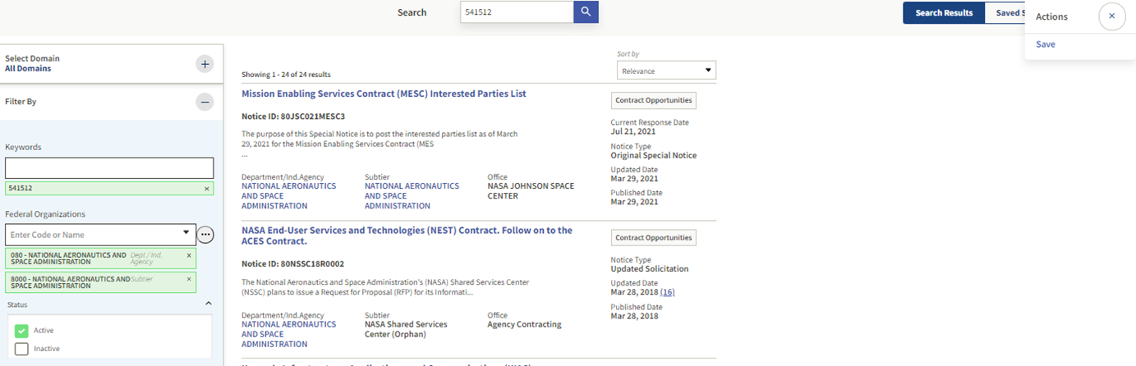

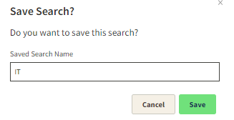

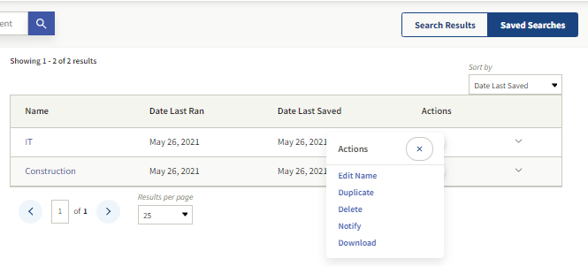
Save Searches and Set Up Notifications for Contract Opportunities in SAM.gov.

Slide 26
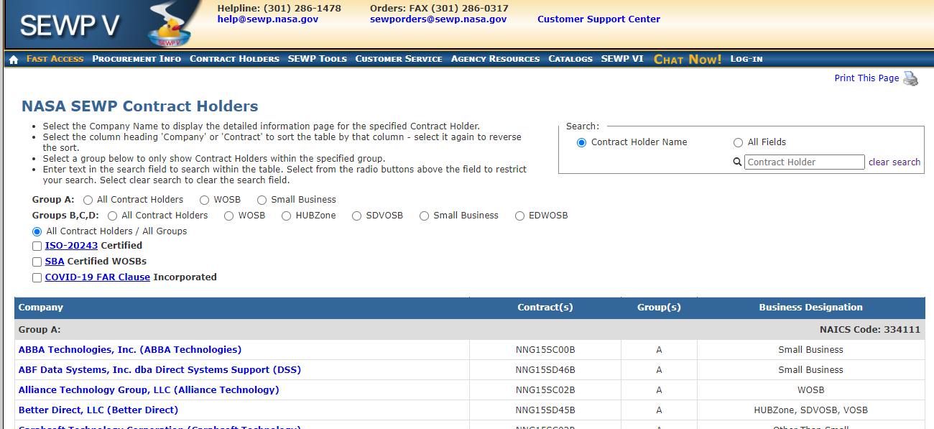
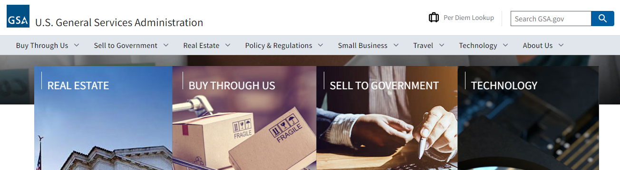
Contract Opportunities
https://sewp.nasa.gov/
https://www.gsa.gov/

Slide 27

Getting a Contract w/NASA Takes Time:
Setting Expectations
Building a relationship with federal agencies takes time
  Find an advocate – Small Business Specialist
  Attend outreach events (E.g., In-person and virtual)
  Build coalitions with other companies at NASA
    Reach out to industry Small Business Liaison Officers (SBLO)
  Take advantage of business-to-business networking opportunities
Research and/or join Center Industry Councils
Be open to NASA Mentor-Protégé Program opportunities
Remember the process is long term if you want success
  Adjust your business strategy as needed

Slide 28
Getting a Contract w/NASA Takes Time:
Setting Expectations
Learn about NASA 's various missions
  Each NASA Center has different Missions
  Varied mix of products and services
Respond to and review NASA Sources Sought and Request for Information solicitations
Use Small Business resources:
  NASA Acquisition Forecast and Active Contract Listings
    NASA OSBP Mobile App and OSBP Website
  APEX Accelerators (formerly Procurement Technical Assistance Centers) and Small Business Development Centers (SBDC)
  Small Business Administration (SBA) and Service Corps of Retired Executives (SCORE)

Slide 29

Small Business Procurement Scorecard Achievement
FY 2022 – A (102.49%)
FY 2021 – A (106.23%)
FY 2020 – A (104.57%)
FY 2019 – A (107.22%)
FY 2018 – A (103.10%)
FY 2017 – A (105.64%)
29

Slide 30
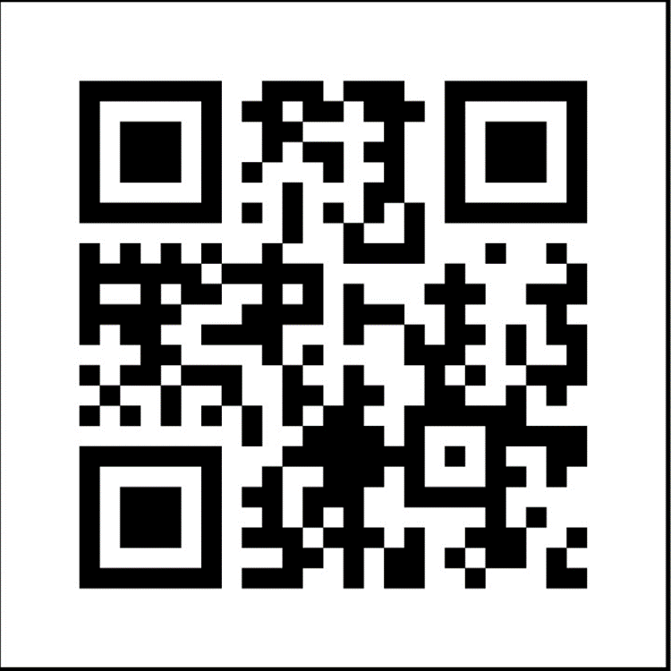
nasa.gov/osbp
NASA Office of Small Business Programs QR Code

Slide 31
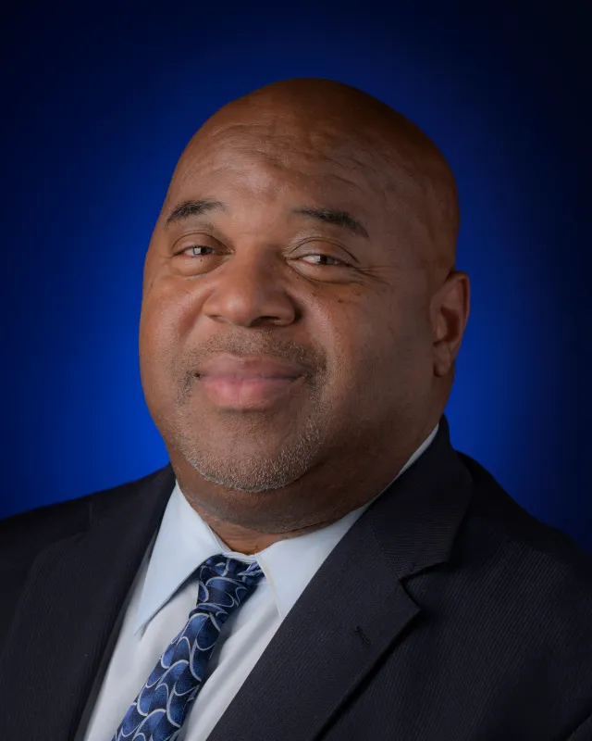
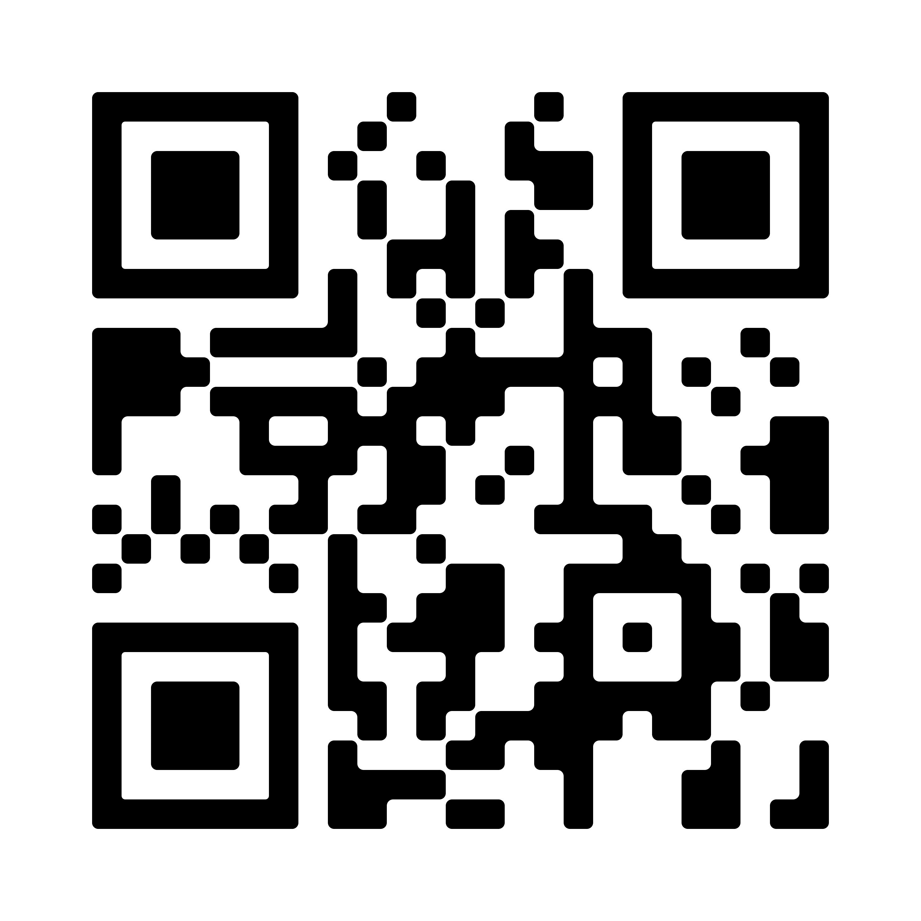
How to Do Business with NASA – Experienced Entrant
Mr. Andre Sheppard
Acting Director, Procurement Strategic Operation Division
NASA Office of Procurement

Slide 32
Pathway to Procurement at NASA
January 17, 2023
Mr. Andre Sheppard
Acting Director
NASA HQ Procurement Strategic Operations Division

Slide 33
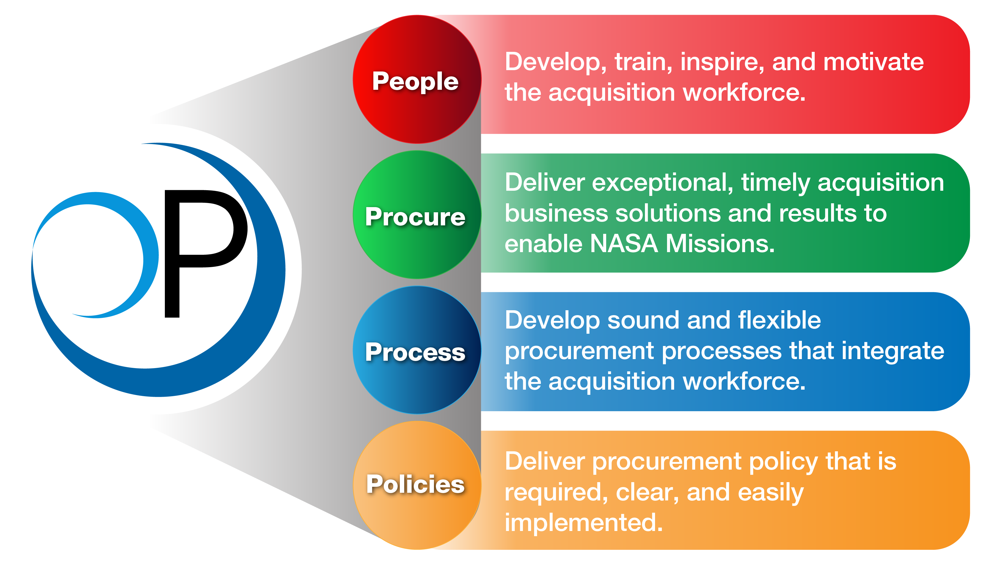
Office of Procurement
Mission and Vision
VISION
Explore and execute innovative, effective, and efficient acquisition business solutions to optimize capabilities and operations that enable NASA’s missions.
MISSION
Acquisition excellence in an evolving environment.

Slide 34





FY 2024 Procurement Initiatives
Focus Areas
Maintain a Robust Procurement Enterprise and Data Analytics
Reinvigorate Contract Administration
(Peer Reviews & Pricing)
Strengthen Grants/Cooperative Agreements
(Policy & Operations)
Amplify Industry Engagement & Innovation
(NAIL & Vendor Comms)
Acquisition Excellence Through Better Acquisition Outcomes
Notes:
Maintain Robust Procurement Enterprise
a. Re-Alignment of Research Centers/org structure
b. NOJMO/FFRDC Contracting
c. Re-Alignment of NSSC/SSC org structure
d. Policy/Process/Procedures
e. IT Tools continuous improvement (including metrics)
Reinvigorate Contract Administration
a. Contract Change management
b. Pricing and Negotiation
c. Surveillance Tools/Techniques
d. PMR/Self-Assessments/Audits
Strengthen Grants/Cooperative Agreements
a. Policy/Governance
b. Operations
c. Org structure review and analysis
Amplify Industry Engagement & Innovation
a. Maintain focus on new entrants and underutilized socioeconomic contractors
Acquisition Excellence Through Better Acquisition Outcomes
a. FAC-C Modernization
b. Credentialing
c. Recruitment/Retention
d. On the Job Training/Succession Planning

Slide 35
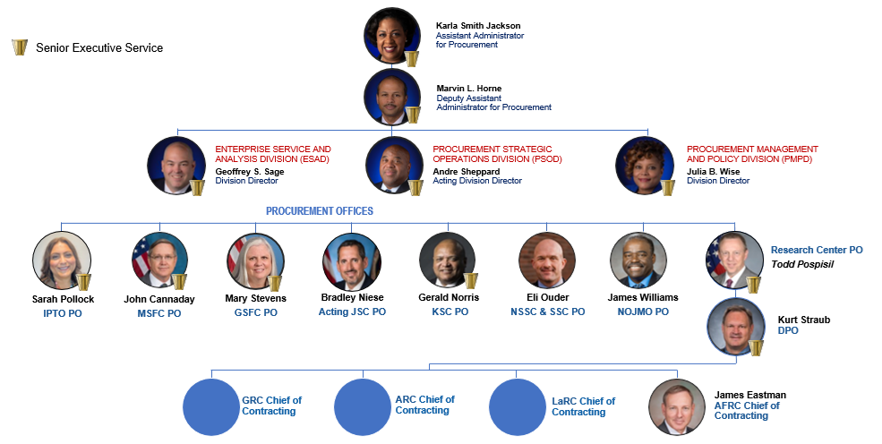
Office of Procurement Leadership

Slide 36













OP Vision Statement: Acquisition Excellence in an Evolving Environment
Learn the NASA Contracting Locations
OP Enterprise
Research Centers
Space Flight Centers
Headquarters OP
Provides stewardship of acquisition process to support successful accomplishment of mission objectives. Provide policy, oversight, optimization of procurement resources, and support Mission Directorate Acquisition Strategy Development to enable more efficient operations for NASA.
Ames Research Center - Specializes in research geared toward gaining new knowledge and creating new technologies that span the spectrum of NASA interests.
Goddard Space Flight Center - Goddard's mission is to expand knowledge about Earth and its environment, the solar system, and the universe through observations from space.
Marshall Space Flight Center - Marshall is the world's leader in the access to space and the use of space for research and development to benefit humanity.
Information Technology (IT) Procurement Office - Developed as a part of NASA’s transformation to enable the Agency to leverage best practices related to IT, create standardization, and maintain pace with the constant change amongst the IT industry.
Armstrong Flight Research Center - As the lead Center for flight research, Armstrong continues to innovate in aeronautics and space technology. The newest, the fastest, the highest -- all have made their debut in the vast, clear desert skies over Armstrong.
Space Centers
NASA Office of JPL Management and Oversight – NOJMO ensures proper coordination of all the required operational functions associated with the management of the FFRDC, the JPL contract, and is the focal point for communication with upper management at the JPL and actively represents NASA in local outreach and educational events.
Glenn Research Center - Glenn develops and transfers critical technologies through research, technology development, and systems development for safe and reliable aeronautics, aerospace, and space applications.
Kennedy Space Center - Kennedy is "America's Gateway to the Universe" -- leading the world in preparing and launching missions around Earth and beyond.
Johnson Space Center - Leads NASA’s efforts in human space exploration, from the early Gemini, Apollo, Skylab and space shuttle programs to today's International Space Station and Orion programs.
NASA Shared Services Center - Supports NASA’s overall mission by providing core procurement services across the Agency; award /administration of grants and cooperative agreements; research & development contracts; complex, large dollar service contracts; and commercial item acquisitions.
Langley Research Center - Langley continues to forge new frontiers in aviation and space research for aerospace, atmospheric sciences, and technology commercialization to improve the way the world lives.
Stennis Space Center - Stennis is responsible for NASA's rocket propulsion testing and for partnering with industry to develop and implement remote-sensing technology.

Slide 37

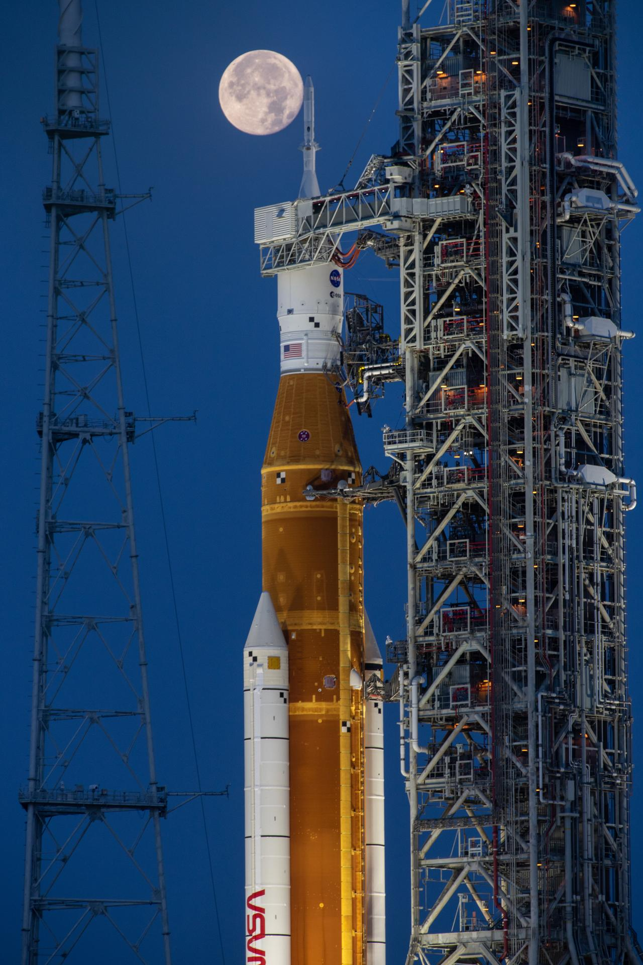
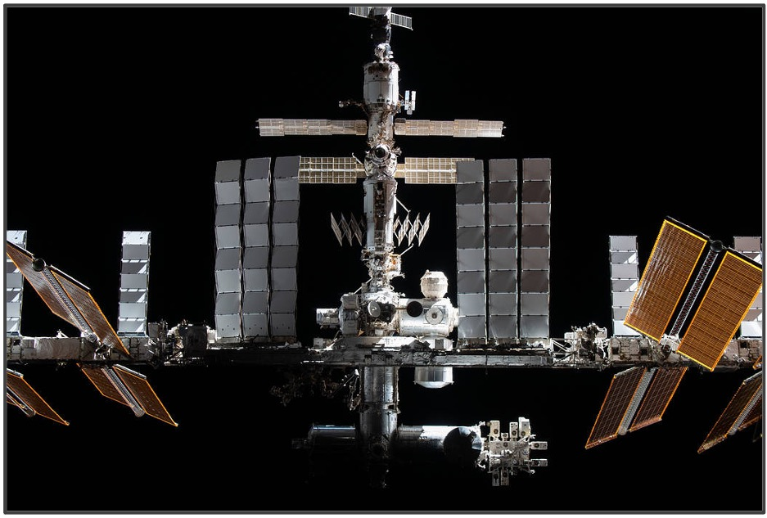

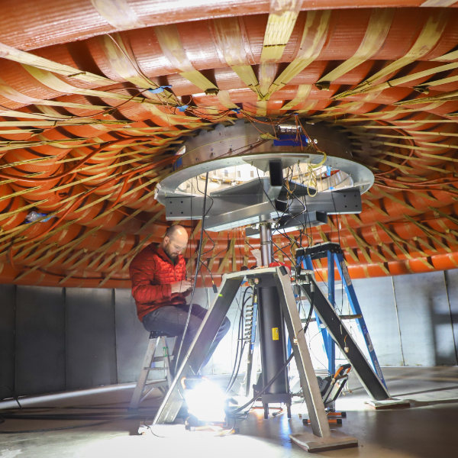
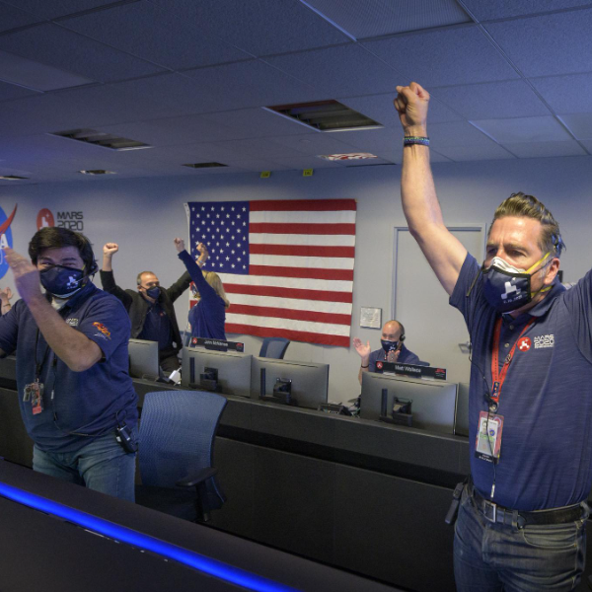
NASA Mission Directorates (How We Do Business)
AERONAUTICS RESEARCH
EXPLORATION SYSTEMS DEVELOPMENT
SPACE OPERATIONS
SCIENCE
SPACE TECHNOLOGY
MISSION SUPPORT DIRECTORATE
Responsible for enabling sustained human exploration missions and operations in our solar system. NASA’s Space Operations Mission Directorate (SOMD) manages NASA’s current and future space operations in and beyond low-Earth orbit, including commercial launch services to the International Space Station.
Engages the Nation's science community, sponsors scientific research, and develops and deploys satellites and probes in collaboration with NASA's partners around the world.
SPACE TECHNOLOGY
Research directly benefits today's air transportation system, the aviation industry,
and the passengers and businesses who rely on aviation every day.
Technology drives exploration to the Moon, Mars and beyond. NASA’s Space Technology Mission Directorate (STMD) develops transformative space technologies to enable future missions.
Provide effective and efficient institutional support to enable successful accomplishment of NASA mission objectives.
Responsible for the progress in designing and building capabilities to explore a variety
of deep space destinations.

Slide 38
Acquisition Governance
Competition In Contract Act (CICA)
  FAR – Federal Acquisition Regulations
    Codifies uniform policies for acquisition of supplies/services for executive agencies
    52 parts – plus numerous clauses/provisions
Agency FAR Supplement (i.e., NFS, DFARS, etc.)
  Supplements FAR requirements to reflect unique NASA/Agency policy. Several agencies have their own internal supplement.
2 Code of Federal Regulations (CFR) Title 2 – Grants and Agreements
  2 CFR 200.24: Cooperative Agreement
  2 CFR 200.51: Grant Agreement
Competition In Contract Act (CICA)
  FAR – Federal Acquisition Regulations
    Codifies uniform policies for acquisition of supplies/services for executive agencies
    52 parts – plus numerous clauses/provisions
Agency FAR Supplement (i.e., NFS, DFARS, etc.)
  Supplements FAR requirements to reflect unique NASA/Agency policy. Several agencies have their own internal supplement.
2 Code of Federal Regulations (CFR) Title 2 – Grants and Agreements
  2 CFR 200.24: Cooperative Agreement
  2 CFR 200.51: Grant Agreement

Slide 39
Acquisition Process
Fundamentals of the Acquisition Process
  Define Requirement
  Prepare Statement of Objectives (SOO), Statement of Work (SOW) or Performance-based Work Statement (PWS)
  Obtain funding
  Perform market research
  Determine acquisition strategy
  Procurement/Contracting Process (negotiations/award)
  Performance
  Closeout
  Deliverables

Slide 40

Takeaways
It is a business decision to enter into the Federal Government Acquisition Process!
    Ensure you have the right “expertise” on the team
Know the business, check these sites daily:
    https://sam.gov
    https://nspires.nasaprs.com
    https://www.grants.gov
  Be responsive if contacted by a federal agency!
  Ensure you have the appropriate systems to perform the work

Slide 41
Takeaways
Get out there!
    Go to Pre-Proposal Conferences/Vendor/Pitch Days (not only meet industry, but meet the Agency players).
    Don’t wait for industry or Government agency to come to you
Invest in Training and Continuing Education
    Train the business team; get certified!
    Maintain certifications through continuing education courses.
    Take advantage of Webinars

Slide 42
Upcoming External Engagements
Date | Event | Organized by
January 25, 2024 | Small Business, Big Opportunities, Pathways to Procurement at NASA | NASA Office of Small Business Programs
January 31, 2024 | ACT-IAC AI Acquisition Forum | ACT-IAC
February 5, 2024 | NCMA Atlanta Chapter Roundtable | National Contract Management Association
February 5 - 7, 2024 | The National 8(a) Association National Small Business Conference | The National 8(a) Association
February 14 - 15, 2024 | ASCENDxTexas: Pathways for Our Success: Breaking Barriers & Accelerating the Space Ecosystem | ASCENDxTexas
February 26, 2024 | NASA Forum at CIAA | OSTEM
February 27 - 28, 2024 | AMADS Conference | Defence iQ
March 3 - 6, 2024 | NCMA Nexus Conference | NCMA
March 25 - 27, 2024 | Americas Procurement Leaders Congress 2024 | Procurement Leaders
April 8 - 11, 2024 | 39th Space Symposium | Space Foundation
April 16-18, 2024 | NASA HBCU/MSI Technology Infusion Road Tour at at Clark Atlanta | NASA Office of Stem Engagement
April 28-30, 2024 | PSC Annual Conference 2024 | PSC
TBD 2024 | United States Pan Asian American Chamber of Commerce (USPAACC) Innovation Symposium | USPAACC
May 14-16, 2024 | World Procurement Congress 2024 | Procurement Leaders
June 4, 2024 | Procurement and Supply Chain Live New York | Procurement and Supply Chain Live
July 21-24,2024 | NCMA World Congress | NCMA

Slide 43
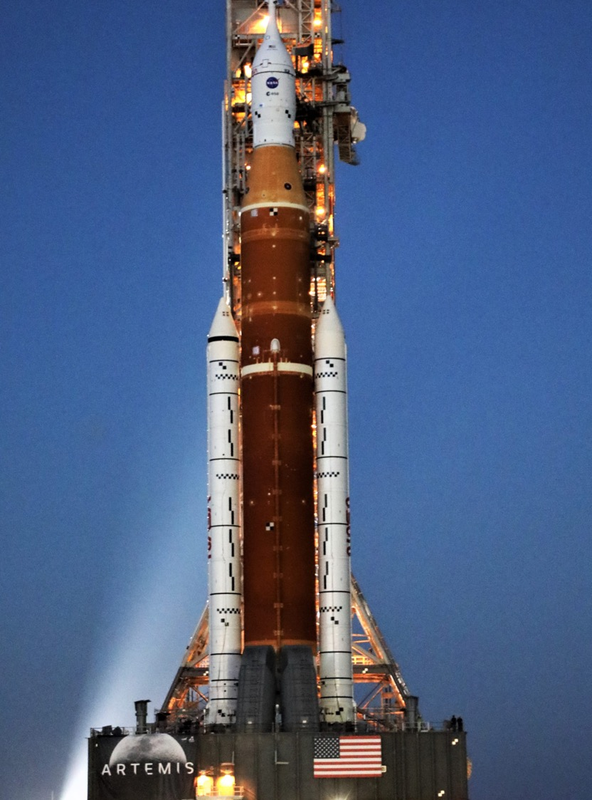
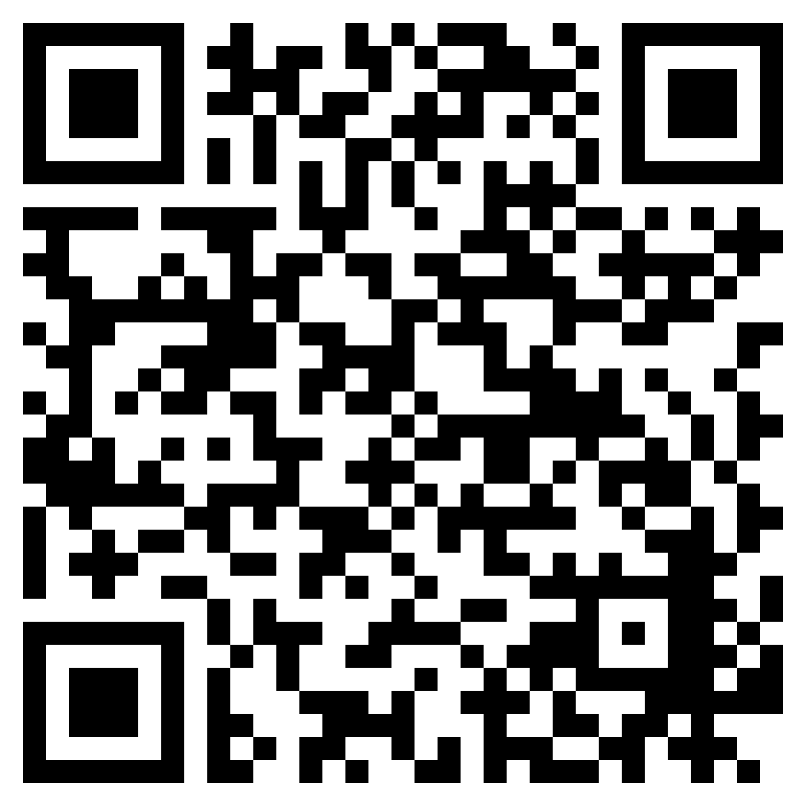
Scan to view the NASA Acquisition Forecast, or visit: https://www.hq.nasa.gov/office/procurement/forecast/index.html
Thank You

Slide 44

Ask Me Anything with NASA
Moderator:
Ms. Briana L. Goins, Program Specialist
NASA Office of Small Business Programs
Panelists:
Kandace P. Chappell, Small Business Specialist
NASA Goddard Space Flight Center
Kay S. Doane, Small Business Specialist
NASA Stennis Space Center
Andre Sheppard, Supervisory Procurement Analyst
NASA Office of Procurement

Slide 45
OSBP UPDATES

Slide 46


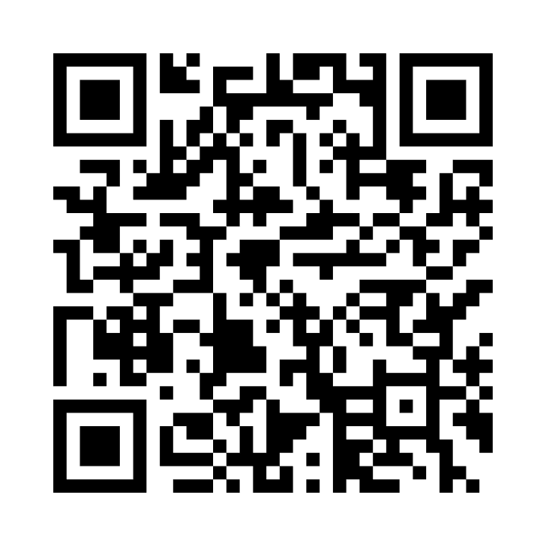
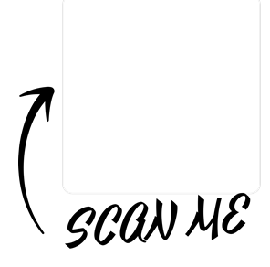
Upcoming OSBP Outreach Event & Webinars
Upcoming OSBP Learning Series Webinars
February 16, 2024
NASA Historically Black Colleges and
Universities Opportunities
March 20, 2024
Women Changemakers and Small Business Success at NASA
Upcoming OSBP Outreach Events
April 2024
NASA and Partners Small Business and HBCU Summit: Create, Connect & Collaborate (In-Person)
Howard University Washington, DC
July 2024
Additional information coming soon….

Slide 47

“NASA and Partners Small Business and HBCU Summit: Connect, Collaborate, and Create”
Outreach Event (In-Person)
Date: Friday, April 5, 2024
Time: 8:00am - 3:00pm ET
Location: Howard University School of Business (HUSB)
The Summit is an exclusive opportunity to explore federal contracting opportunities with NASA and its partners while fostering collaboration with Historically Black Colleges and Universities (HBCUs). The "NASA and DCSBDC Small Business and HBCU Summit" is a dynamic event designed as the gateway for small businesses and educational institutions to forge valuable connections within the aerospace and technology sectors.
Attendees can expect to directly engage with other “like-minded” industry counterparts, NASA representatives, and various small business experts. Attendees will also gain insight and participate in interactive sessions led by NASA procurement specialists, where you'll receive valuable information on navigating the federal contracting process in addition to curated breakout sessions.

Slide 48
NASA Small Business Listening
Session Series
NEW in FY24!!
The NASA Office of Small Business Programs (OSBP) Small Disadvantaged Business (SDB) listening session series is a collaborative platform aimed at promoting dialogue, understanding challenges, exploring opportunities, and strengthening support mechanisms to empower small disadvantaged businesses in their engagement with NASA's procurement activities.
Engagement and Collaboration
Feedback Collection
Identifying Challenges and Opportunities
Enhancing Support and Resources
Promoting Equity and Inclusion
Building Relationships and Networks
For more information, visit: https://www.nasa.gov/osbp/osbp-outreach-events/

Slide 49
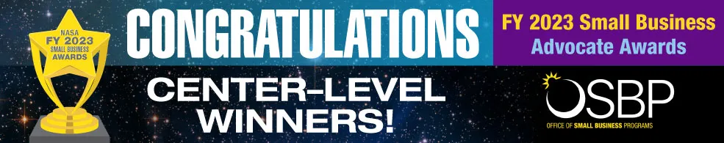
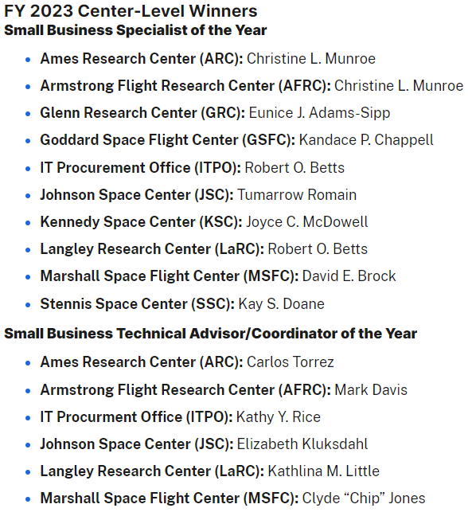
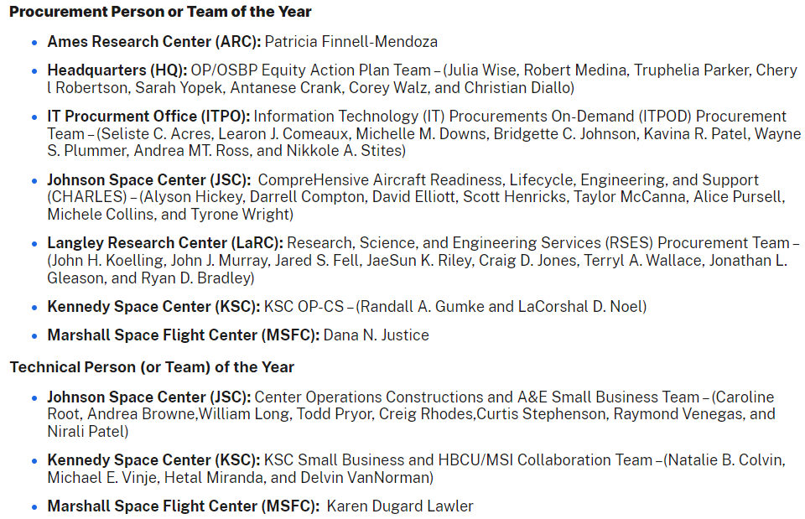
18

Slide 50
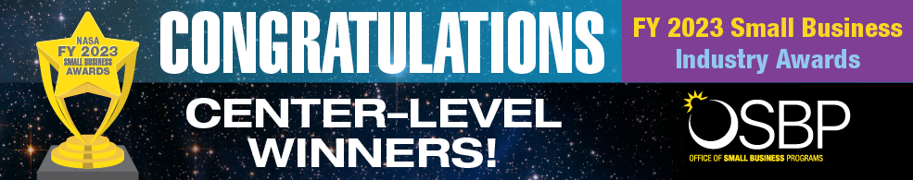
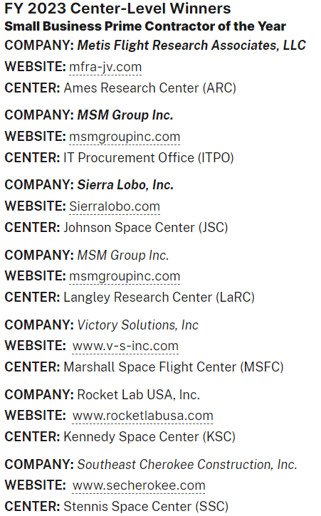
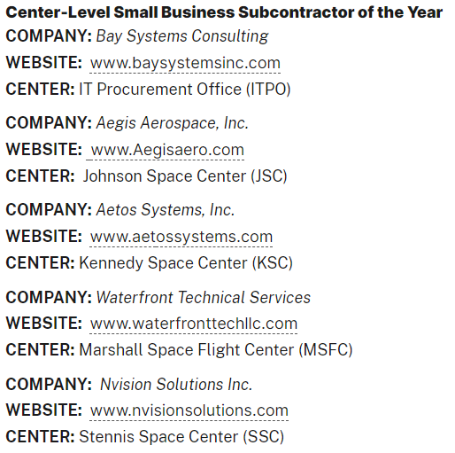
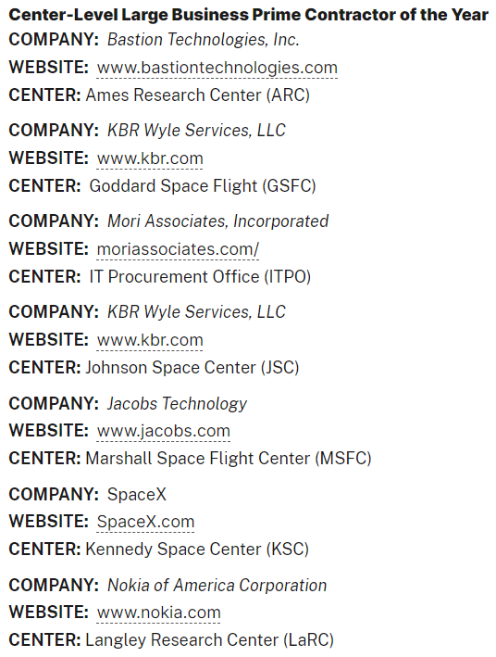
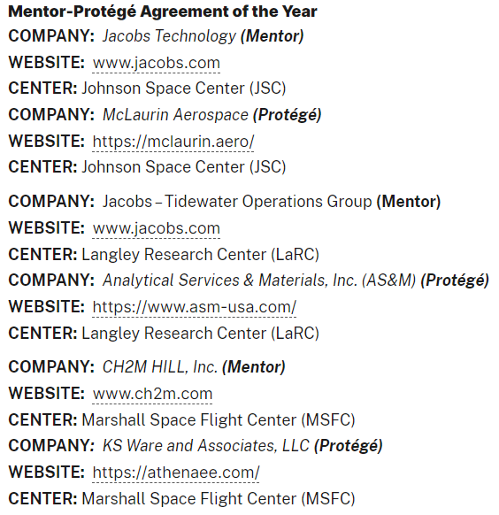
19

Slide 51
OSBP Publications
OSBP provides many resourceful publications to the small business community.
The Small Business Guide to NASA
Small Business Industry Awards
NASA OSBP Spotlight
Other Publications
To view/download, visit:
https://www.nasa.gov/osbp/osbp-publications

Slide 52



OSBP Gets Social! Follow Us!!
@NASA_OSBP
NASA Office of Small Business Programs-
NASA OSBP
Check out NASA’s LinkedIn page for OSBP updates!

Slide 53
Learn more about
NASA OSBP!
www.nasa.gov/osbp

Slide 54

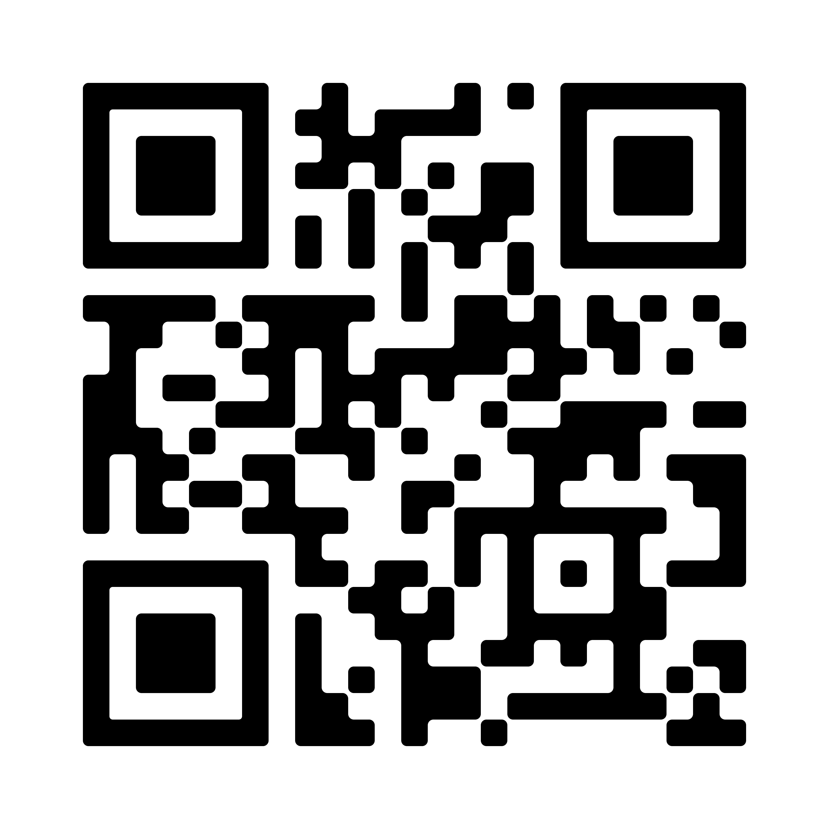
Closing Remarks
Ms. Briana L. Goins
Program Specialist
NASA Office of Small Business Programs
Phone: (202)-358-2088
Email: smallbusiness@nasa.gov

Slide 55


