Slide 1
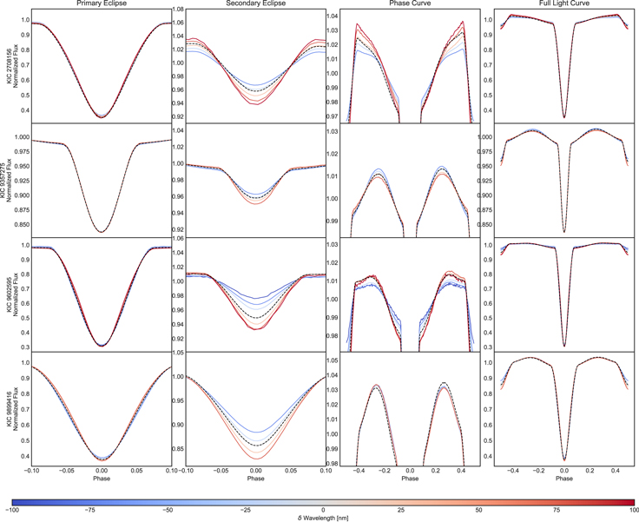
How Adding Color to Kepler Data Unlocks New Science
What is the science question? NASA’s Kepler mission has revolutionized the fields of exoplanets and stellar astrophysics. However, Kepler was limited to a single bandpass, with just one averaged wavelength of light – obtaining a ”black and white” picture of the night sky.
What were your findings? Using modern data analysis methods and capitalizing on small imperfections in the optical system of the telescope, we have been able to show that it is possible to “colorize” Kepler data, and obtain true color information from this monochromatic data. Access to this color information can unlock new science.
Why does this matter? The Kepler data is nearly a decade old, but by revisiting it with state-of-the-art analysis techniques and an understanding of the optics and detector, we’ve demonstrated it’s possible to recover color information from a telescope originally designed to be monochromatic. We can use the technique to better understand stellar flares and tell the difference between stellar binaries and planets. In the future, we anticipate this technique could be applied to data from NASA’s TESS mission.
C. Hedges, R. Luger, J. Dotson, D. Foreman-Mackey, and G. Barentsen, “Multiwavelength Photometry Derived from Monochromatic Kepler Data”, Astronomical Journal, 161, 95, (2021).
Color light curves of eclipsing binaries derived from Kepler data. These light curves show the wavelength dependence of the eclipsing binary phase curve, eclipse depth, and limb darkening – providing previously unavailable details about the temperatures and atmospheres of these stars.

