Slide 1
Mission Success in CubeSats: Improving the Data Collection Work to Date
Michael Swartwout Parks College of Engineering, Aviation & Technology Saint Louis University
Small Spacecraft Community of Practice: CubeSat Reliability 28 March 2016

Slide 2
Motivation and Objectives
CubeSats: Toys, tools or debris cloud?
Opportunities
Missions: Single-instrument science, constellations
Schedule: Concept-to-operations in under 24 months
Modularity: Form-factor forcing standardized parts
Risks
Capabilities: Reports are confusing, conflated, and/or apocryphal
Cost-to-performance: Is it good? What is good?
Go Fever: Viewed as magic solution
Our Plan
Collect data on missions, teams, performance
Analyze/sort
Identify strengths, weakness and opportunities

Slide 3
Agenda for This Discussion
Define terms
CubeSat
Secondary spacecraft
Data collection: Progress to date
Data collected and sources
Holes in the data
Plan for filling in the holes
Interim Analysis
Census trends (and caveat about forecasting)
Helpful (?) categorizing of programs
Working hypotheses on mission success

Slide 4
What are Secondaries?
Launches are expensive (and underweight)!
Secondaries use excess capacity to fly smaller (riskier?) missions on space-available basis
Milestones
1960: SOLRAD-1 (20 kg, USN) w/Transit-2A (100 kg USN)
1961: Injun-1 (16 kg, U. Iowa) w/Transit-4A & SOLRAD-3
1980: Phase-3A (AMSAT) on Ariane-1
2003: QuakeSat, AAU CubeSat, CanX-1, XI-IV, CUTE-1, DTUSat on Rokot (attack of the CubeSats)
2013: 29 Spacecraft on ORS-3 (11/19) 33 Spacecraft on Dnepr (11/21)
2014: 33 Deployed by ISS over 17 days
More than 1100 secondaries flown (316 in 2014-15)

Slide 5
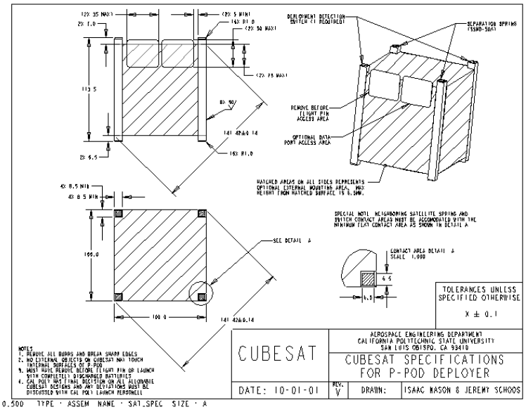
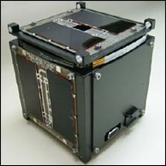
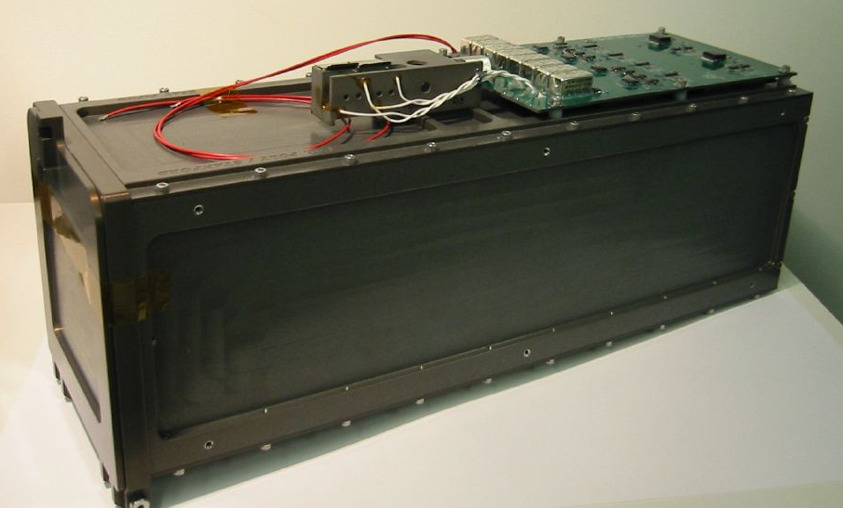
What Is a CubeSat?
Twiggs (Stanford) and Puig-Suari (Cal Poly) defined a standard for carrying 10 cm, 1 kg cubes into space
Enabling/Driving Technology: P-POD
Key feature: launch container
Volume, not mass, is the driver (!)
Timeline
1999 Concept definition, flight validation
2003 First flight with CubeSat specification
2010 70th flight
2012 100th flight; NASA selects 33 CubeSats to fly (backlog of 59)
2014 Planet Labs flies dozens
2015 400th flight
cubesat.org
cubesat.org

Slide 6
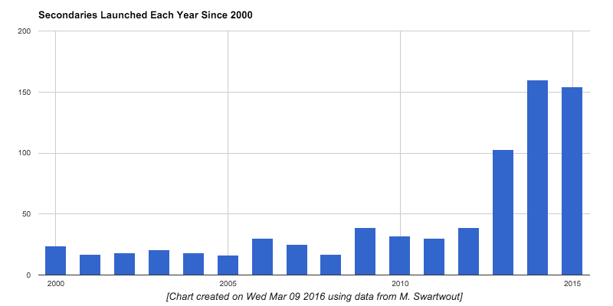
They Just Keep Coming …
Secondary Spacecraft Launched Each Year
150
100
50
2000
2005
2010
2015

Slide 7
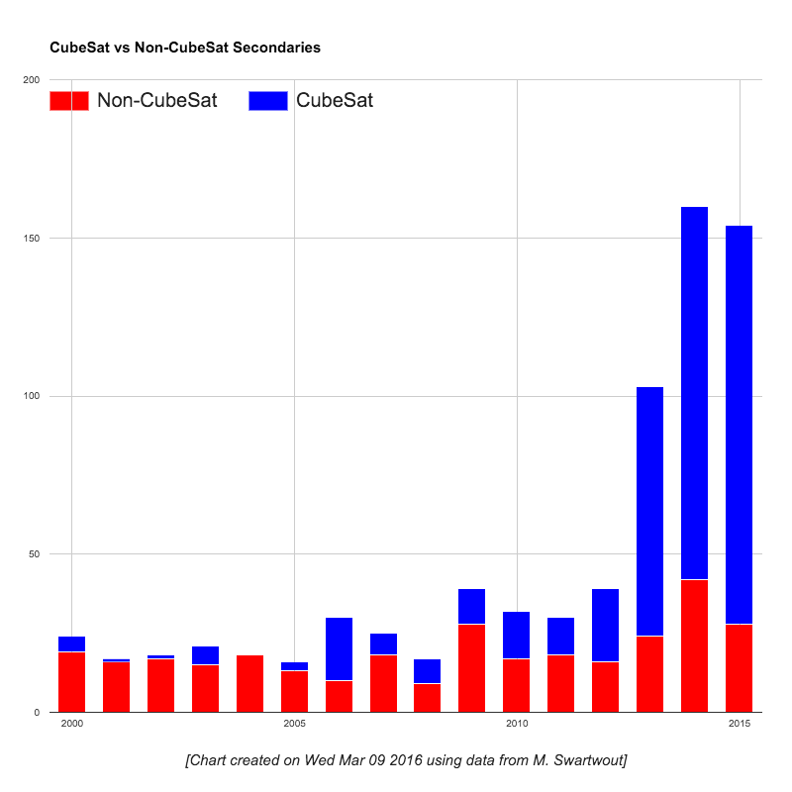
CubeSat vs. Non-CubeSat (2000-2015)
150
100
50
2000
2005
2010
2015

Slide 8
How to Create These Lovely Plots
Scour databases, ask lots of questions
Public: Gunter’s Space Page (international launch log)
Public: Jonathan’s Space Report (orbital elements)
Public: DK3WN Satblog (university/amateur operations)
Public: Union of Concerned Scientists (operational status)
Public: Program websites, conference presentations
Private: Personal communications
Compile information into a central database
“Census” data, plus our own internal assessments
Web-accessible/searchable/plotable
Try not to pull your hair out when several dozen CubeSats deploy in the span of 3 days

Slide 9
In Our Database
Data quality: Complete, partial, incomplete
Census Data
Identifiers (NORAD, COSPAR, Mission Name)
Basic parameters (Mass, size)
Launch and orbit (Launch site, launch date, orbit elements, launch vehicle, ejector, decay date)
Organization (Prime contractor, user/sponsor)
Mission (Description)
Key instruments/components
Mission assessments
Category/type of mission, developer
Mission and functional status
Operational milestones
Not collected (yet?)
Cost

Slide 10
Agenda for This Discussion
Define terms
CubeSat
Secondary spacecraft
Data collection: Progress to date
Data collected and sources
Holes in the data
Plan for filling in the holes
Interim Analysis
Census trends (and caveat about forecasting)
Helpful (?) categorizing of programs
Working hypotheses on mission success

Slide 11
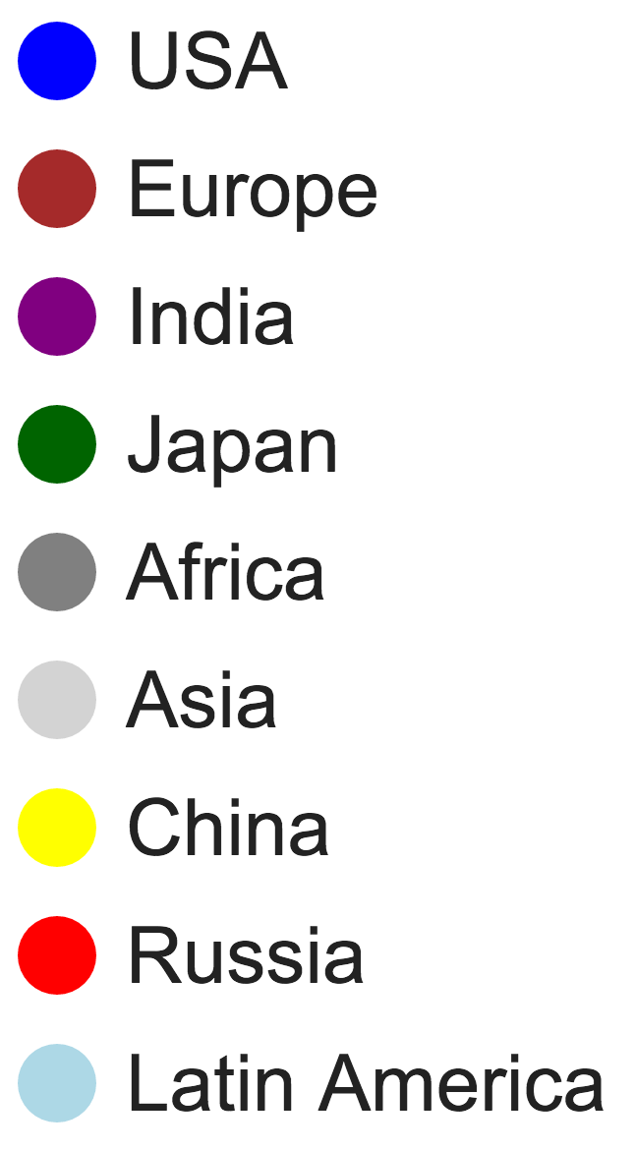
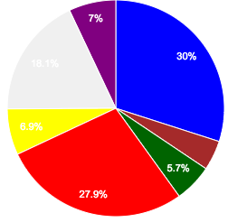
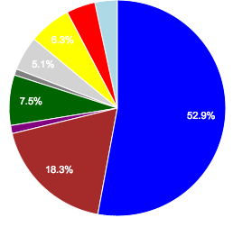
Who Flies (1): By Nation (all secondaries)
Launch Provider
Builder
ISS
Missions By
Launch
Provider
USA
Japan
China
Russia
India

Slide 12
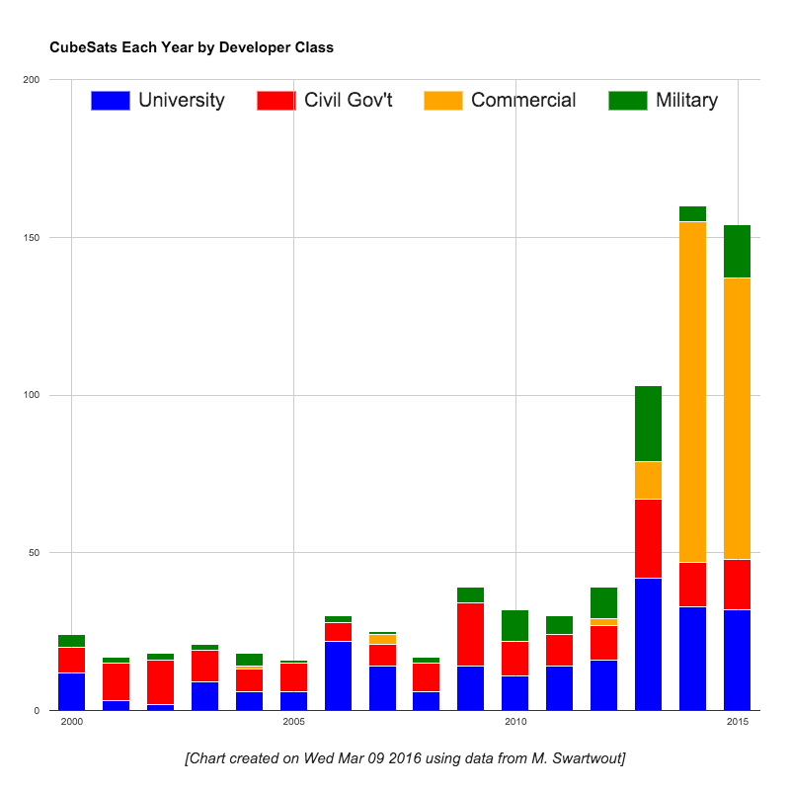
Who Flies (2): Mission Developer Type
150
100
50
2000
2005
2010
2015

Slide 13
Rethinking the Developer Types
These categories are too broad
University: Montana State vs. a high school
Commercial: Boeing vs. SSTL vs. Planet Labs
NASA Ames’ spacecraft have more in common with SSTL than with JPL
New types (I need help with titles!)
Hobbyists
SmallSatters
Traditionalists (e.g., large contractors)
Commercial constellations (Planet Labs, SPIRE)
Only for CubeSats, so far

Slide 14
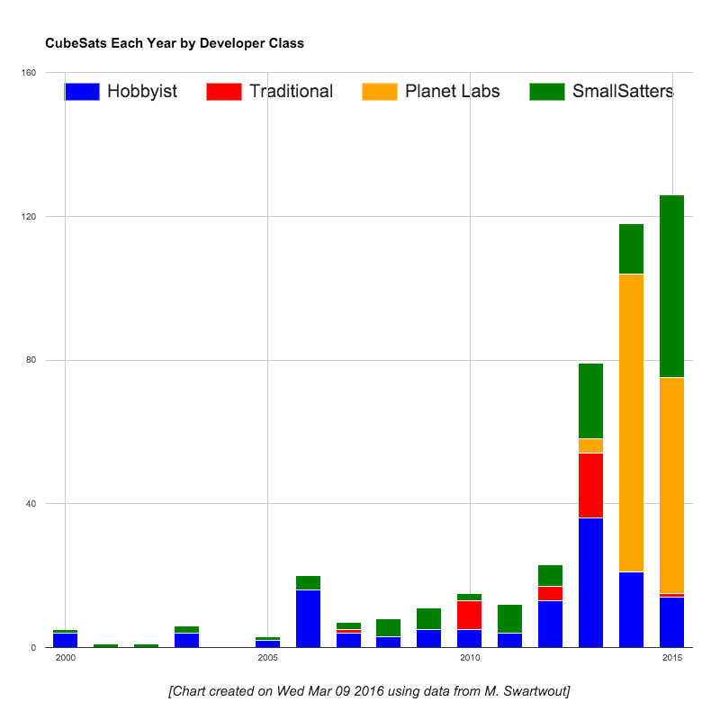
Who Flies (2): Mission Developer Type
120
80
40
2000
2005
2010
2015

Slide 15
Who Flies (3): Mission Type
150
100
50
2000
2005
2010
2015

Slide 16
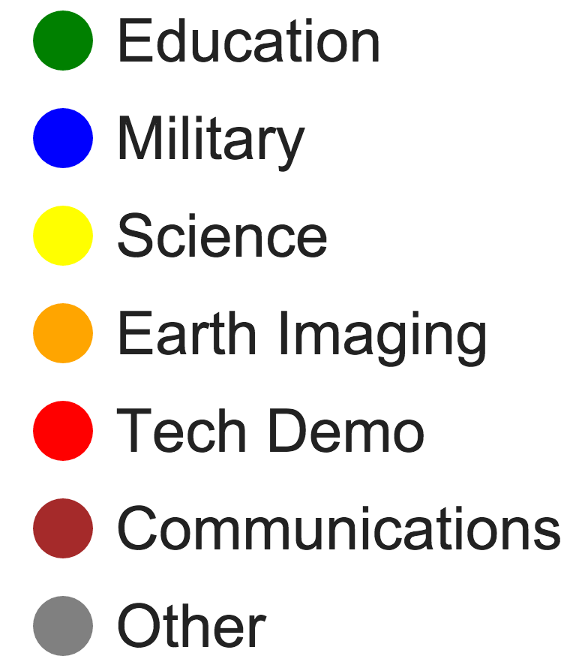
CubeSat Mission Type by Developer Class
SmallSatters
Traditionalists
Hobbyists

Slide 17
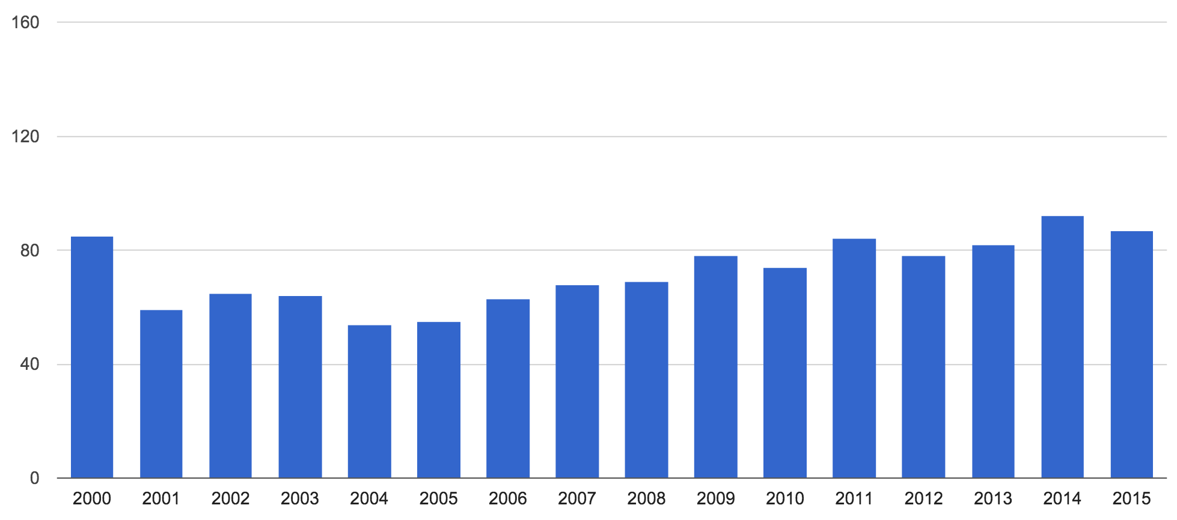
How are they reaching orbit?
Launch Attempts Per Year, Worldwide

Slide 18
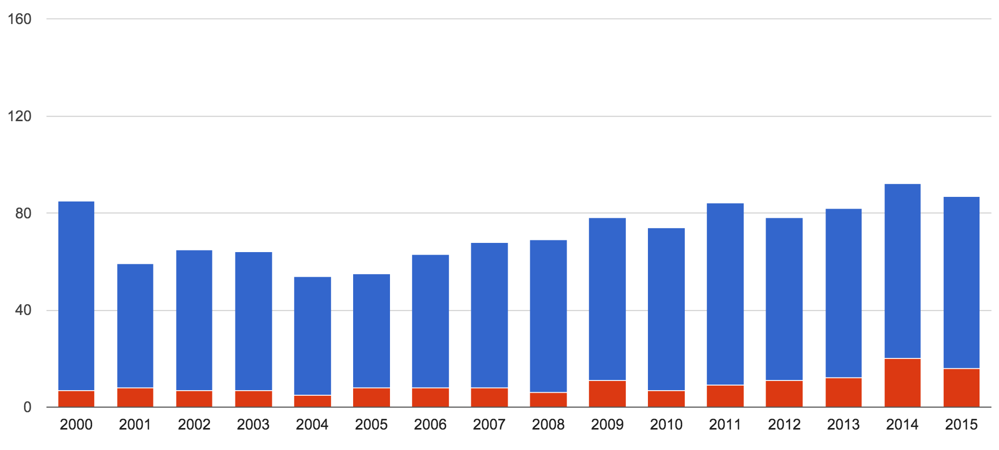
How are they reaching orbit?
Launch Attempts Per Year, Worldwide Launch Attempts with Secondaries

Slide 19
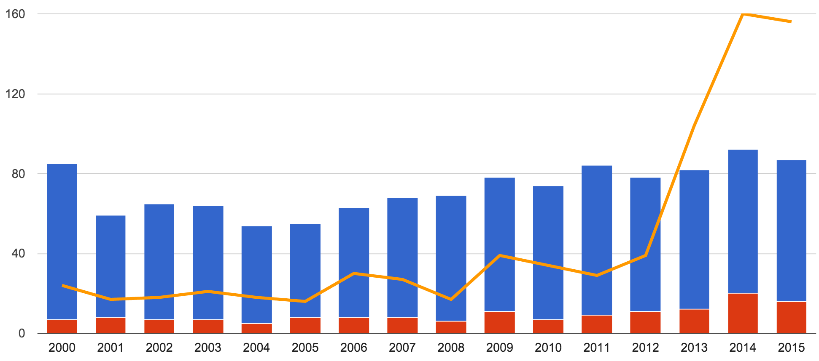
How are they reaching orbit?
Launch Attempts Per Year, Worldwide Launch Attempts with Secondaries
Secondaries Launched

Slide 20
That’s a Lot of Secondaries…
… a whole lot of secondaries!
More secondaries than primaries in 2014-2015
ISS is capable of releasing 100+ per year
ULA, others making 24U standard for launches
We haven’t seen the peak
Is there a business case for a dedicated launcher?
Lots of CubeSats are freeloaders
Would you rather have control over a 24-month launch schedule, or pay (much?) less for a ride 6 months out?

Slide 21
New Definition: Mission Status
Mission status increments at each milestone
0 Prelaunch (Cancelled)
Launched (Launch failure)
Deployed (Dead on Arrival)
Contacted (Premature Failure)
Commissioned (Partial Mission Success)
Primary mission complete (Mission Success)
A mission that stalls at one status is given a success/failure assessment

Slide 22
Mission Status by Launch Year
150
100
50
2000
2005
2010
2015

Slide 23
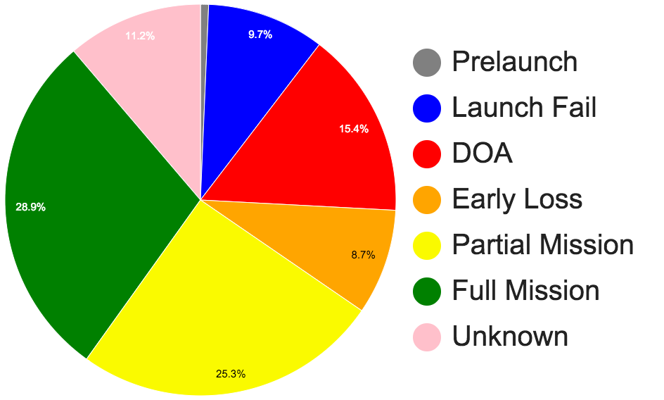
Mission Status by Developer Class
All CubeSats
All CubeSats that launched
Traditionalists
SmallSatters
Hobbyists

Slide 24
Why the discrepancy?
Traditionalists: You get what you pay for!
SmallSatters: Failures appear to be a result of ambitious technology infusion
Hobbyists: Rampant, semi-informed speculation
Lack of time spent on integration & test
Workmanship (?)
Uncaptured best practices?

Slide 25
QA Approach: “Because I Said So!”
Mission Space
Development Approaches that Lead to Mission Failure
Standard CubeSat Acceptance Testing
Hobbyists’ Best Practices
Industry “Best Practices”

Slide 26
Summary and Next Steps
CubeSats (and secondaries) are not a fad
More secondaries than primaries in 2014, 2015, 2016
NanoRacks has enabled commercial swarms (Planet Labs is just the first)
We keep finding new ways to cram in a lot of secondaries
We’re still waiting on a larger equivalent to the P-POD (SSIKLOPS? ESPA?)
Failure rates are what you’d expect (?)
Hobbyists have a lot of challenges
Risk profile seems to explain Smallsatters vs. traditionalists
Uncaptured institutional knowledge!
Improvements to data collection coming online

Slide 27
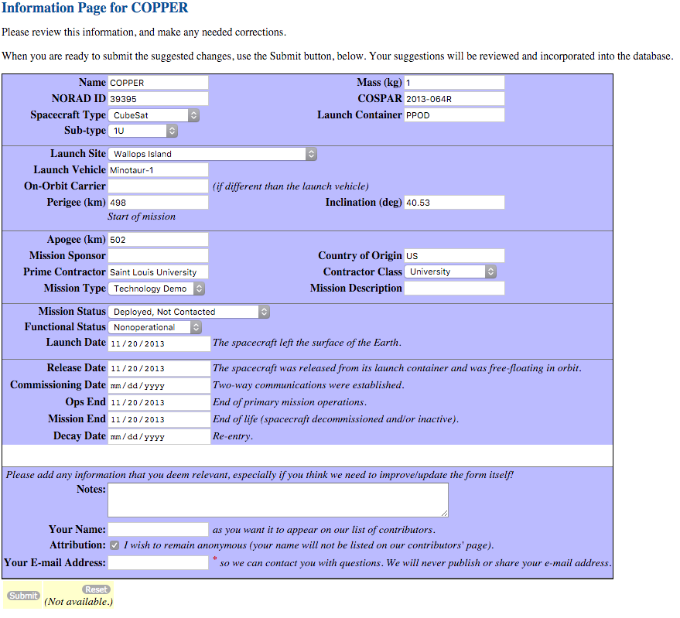
Please, tell your friends
… or tell me, so I can ask them!

Slide 28
Acknowledgements
Data sources
Gunter’s Space Page
Jonathan’s Space Report
Mike Rupprecht, DK3WN
Bryan Klofas
Union of Concerned Scientists’ Satellite Database
Research support
NASA Electronics and Packaging Program

Slide 29
Mission Success in CubeSats: Improving the Data Collection Work to Date
Michael Swartwout Parks College of Engineering, Aviation & Technology Saint Louis University
Small Spacecraft Community of Practice: CubeSat Reliability 28 March 2016

