Slide 1
Water Extraction From Regolith
Presenter: Lara Oryshchyn

Slide 2
NASA’s Journey to Mars
Goal: Live on Mars & Return to Earth Safely
  Sustain Life: Oxygen, Water, Food, Shelter…
  Propellant: Oxygen, Methane
Options: Bring or Utilize Martian Resources
  Atmosphere: CO₂, N₂, Ar, O₂, CO… H₂O (~210ppm)
  Regolith: The uppermost layer of the surface
Notes:
Atmospher:: Major : Carbon Dioxide (CO2) - 95.32% ; Nitrogen (N2) - 2.7% ; Argon (Ar) - 1.6%; Oxygen (O2) - 0.13%; Carbon Monoxide (CO) - 0.08%
Minor (ppm): Water (H2O) - 210; Nitrogen Oxide (NO) - 100; Neon (Ne) - 2.5; Hydrogen-Deuterium-Oxygen (HDO) - 0.85; Krypton (Kr) - 0.3; Xenon (Xe) - 0.08

Slide 3
HESTIA Architecture

Slide 4
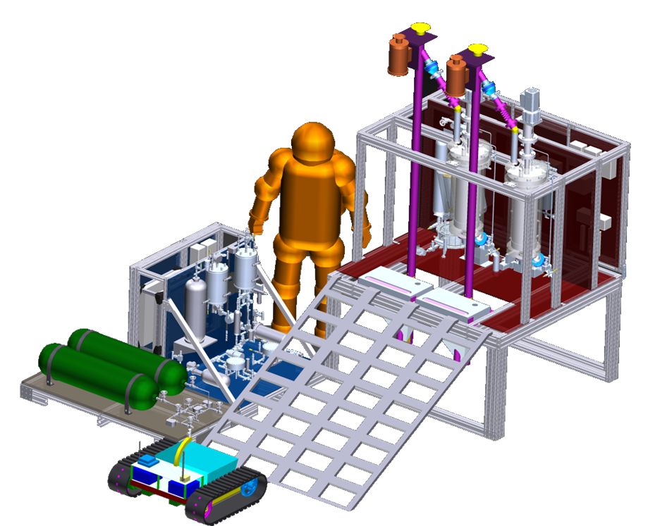
Processing Regolith for Water
EXCAVATION
TRANSPORTATION
WATER EXTRACTION
WATER PROCESSING

Slide 5
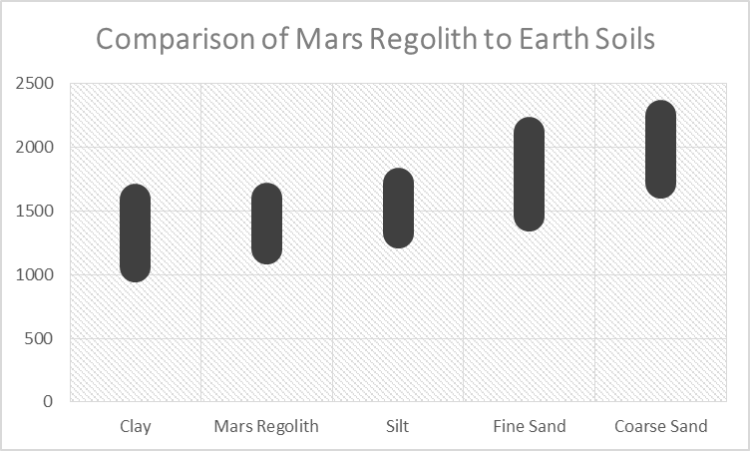
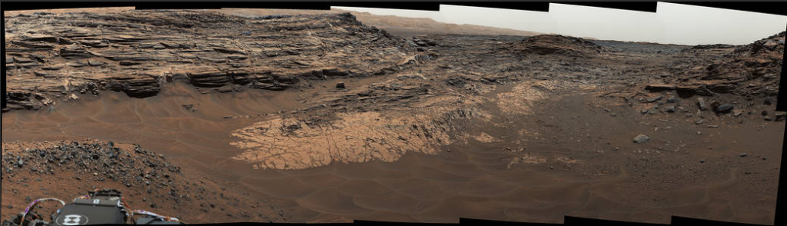

Martian Regolith
Bulk Density: 1200-1600 kg/m³ [Barlow, 95]
Water Content: ~1-10%
  Viking Landers: 1-2% [Anderson et al. 1979]
  Phoenix Lander: ~2% [Smith et al. 2009]
  MSL* Curiosity: ~2-5% [Leshin et al. 2013, Mitrofanov et al, 2014]
  Mars Express Orbiter: >10% [Milliken and Mustard 2007a,b…]
'Marias Pass,' Contact Zone of Two Martian Rock Units
[USGS RMRS-GTR-74,104]
Northward View Along West Rim of Endeavour
Photos: Courtesy of NASA
*MSL: Mars Science Laboratory

Slide 6
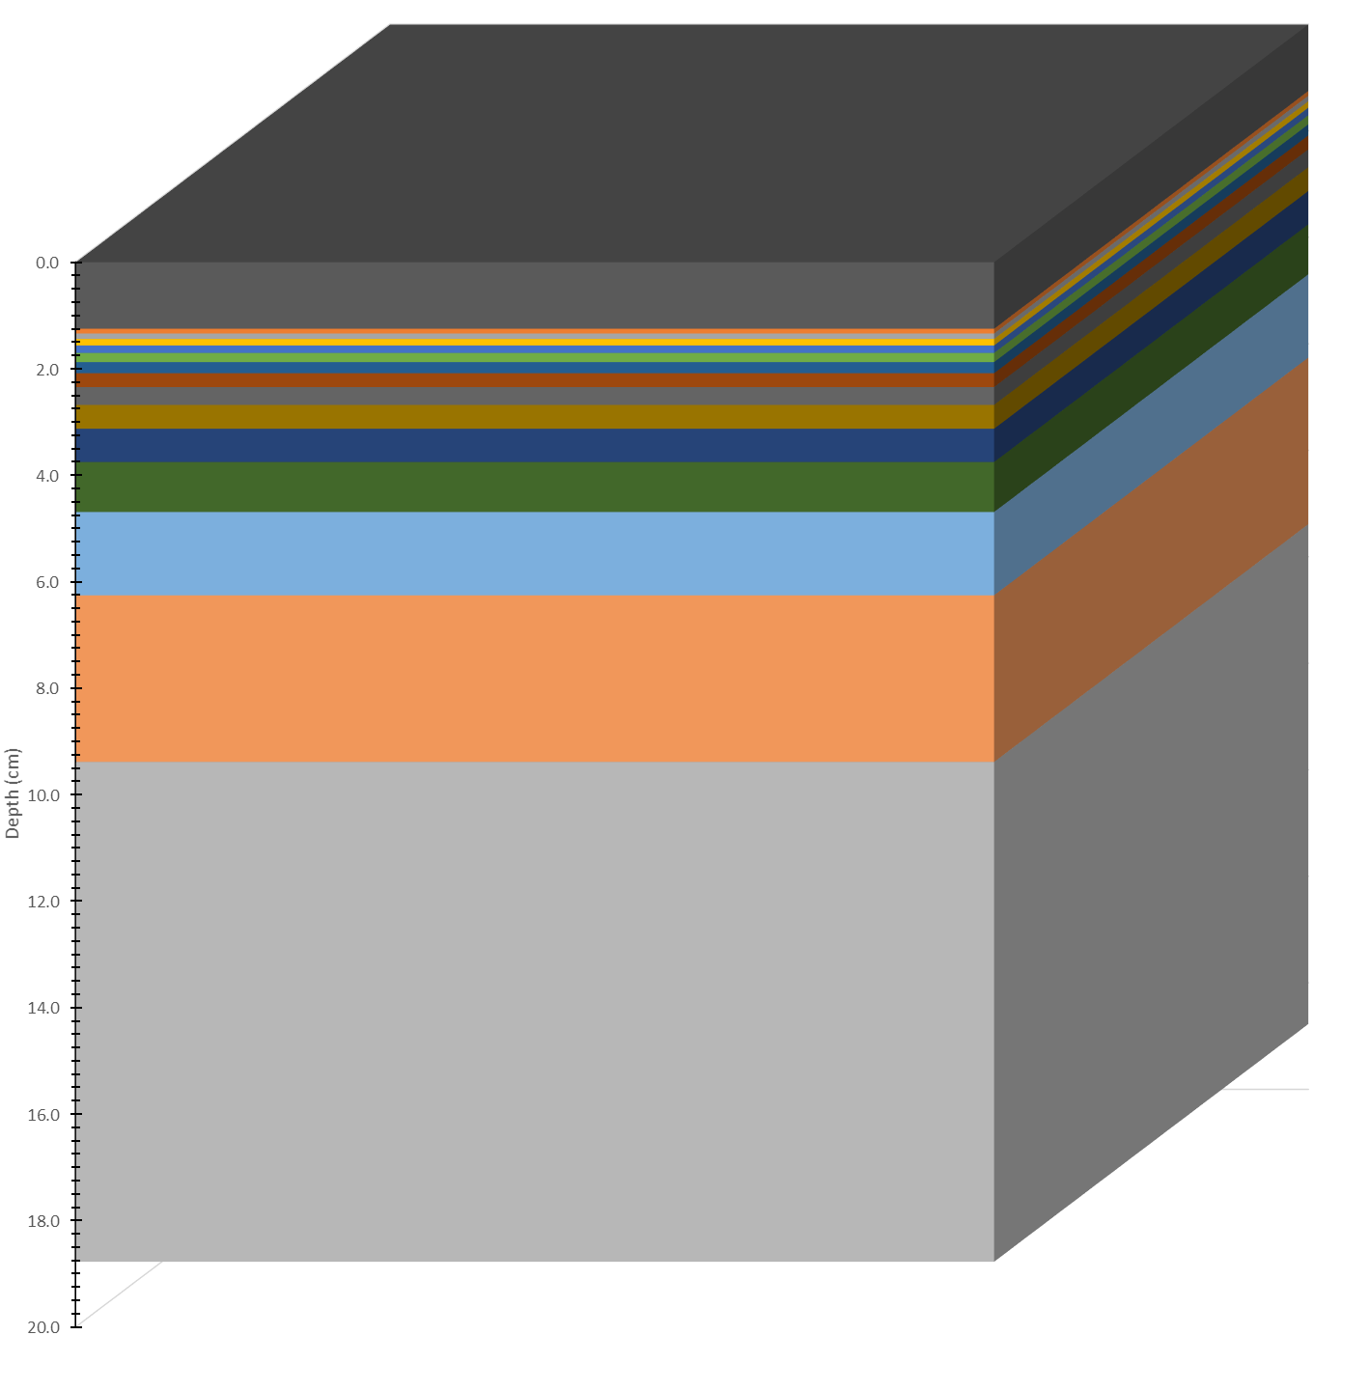
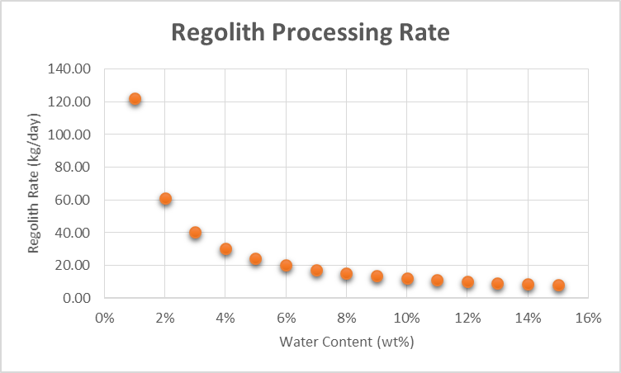
How Much Regolith?
Suggested Per DRA* 5.0 [and subsequent publications]
  Duration: 510 days (480 days contingency)
  Total Oxygen Production: 25,000 kg
    Life Support: ~2,000 kg
    Propellant: ~23,000 kg
Assumptions
  Operating Time: 24 hours/day
  Propellant (O₂/CH₄) Mixture Ratio: 4.0
  Atmospheric Processing with a Sabatier
  → Produces Half the Water
Derived Rates
  O₂ Rate: 2.17 kg/hr (52.1 kg/day)
  H₂O Total Rate: 2.44 kg/hr (58.6 kg/day)
  H₂O Regolith Rate: 1.22 kg/hr (58.6 kg/day)
49 m (160’)
110 m (360’)
15%
3%
2%
1%
Not to Scale
DIG DEPTH BASED ON WATER CONTENT
AMERICAN FOOTBALL FIELD
*DRA: Design Reference Architecture

Slide 7
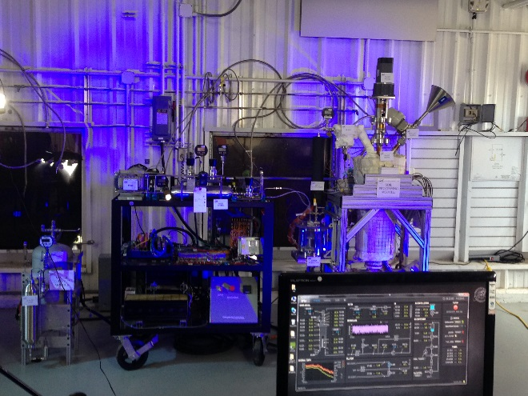
Water Extraction System
AKA: Soil Processing Module (SPM)
History
  OPTIMA* (2007/2008)
    Lunar Regolith Hydrogen Reduction
    JSC-1A Simulant (10 kg)
    1000 Metric Tons of O₂/year
  HESTIA (2015/2016)
    Water Extraction of Martian Regolith
    JSC-Mars-1A Simulant (6 kg)
    Goal: 25,000 kg of O/~500 days
Vertically Agitated Dryer
  Nickname: Sandman
  Capacity:10,400 cm³ (630 in³)
SANDMAN
FLUID SYSTEM
*OPTIMA: Outpost Precursor Testbed for ISRU and Modular Architecture

Slide 8
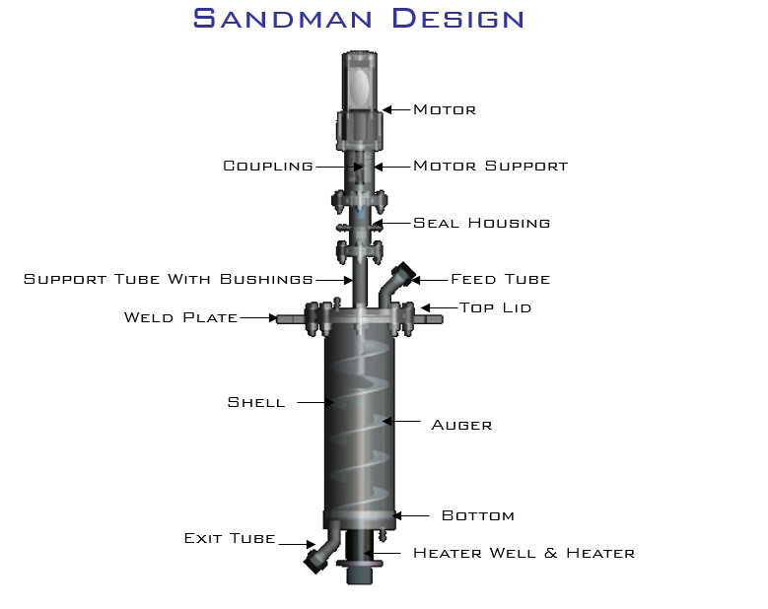
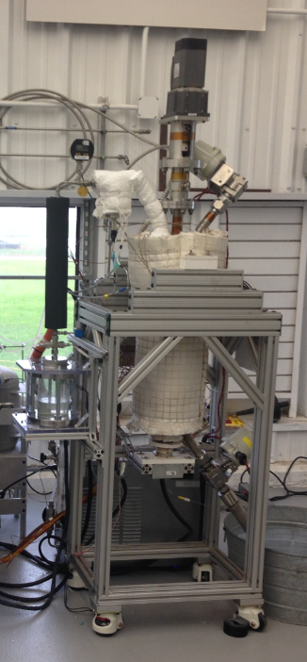
Water Extraction System
58”
24”

Slide 9
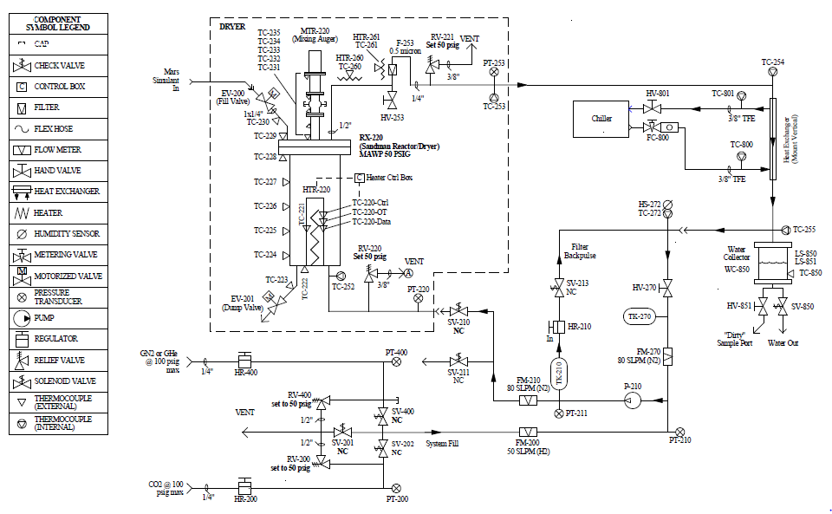
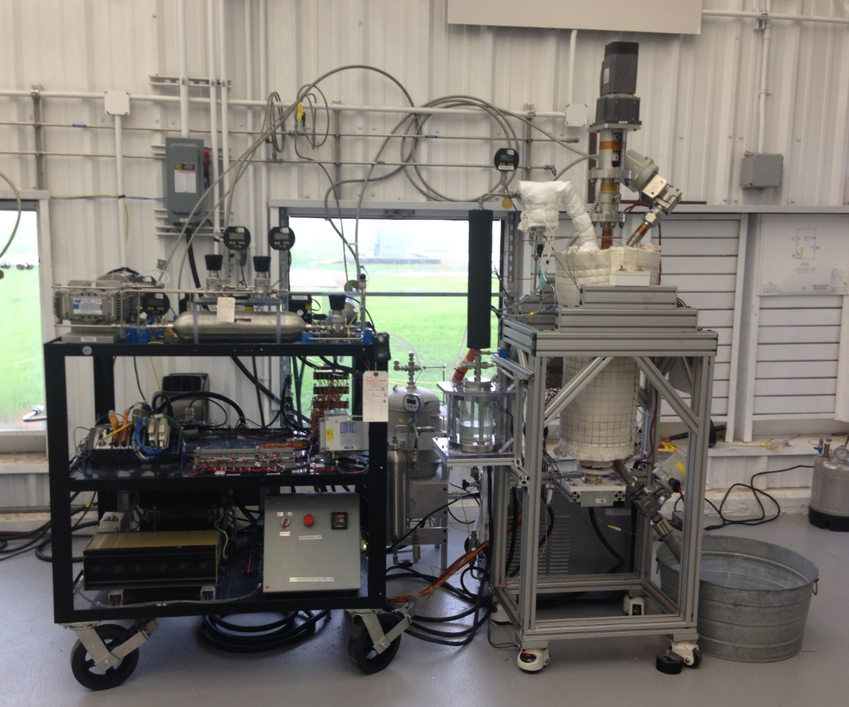
Water Extraction System
PARTICULATE FILTER
HEAT EXCHANGER
SANDMAN
VALVES
WATER COLLECTOR
FLUID SYSTEM
DRYER

Slide 10
HESTIA SPM Testing
Objectives
  Determine water evolution rate using JSC-Mars-1A Simulant
  Evaluate the purity/contaminants of the water produced
  Identify upgrades/changes to the water extraction system
  Identify similarities/differences between Earth/Mars
Test Conditions
  Simulant Quantity: 6 kg
  Operating Pressure: <50 psig
  Operating Temperature: <500ºC
  Sweep Gas: N₂ or CO₂

Slide 11
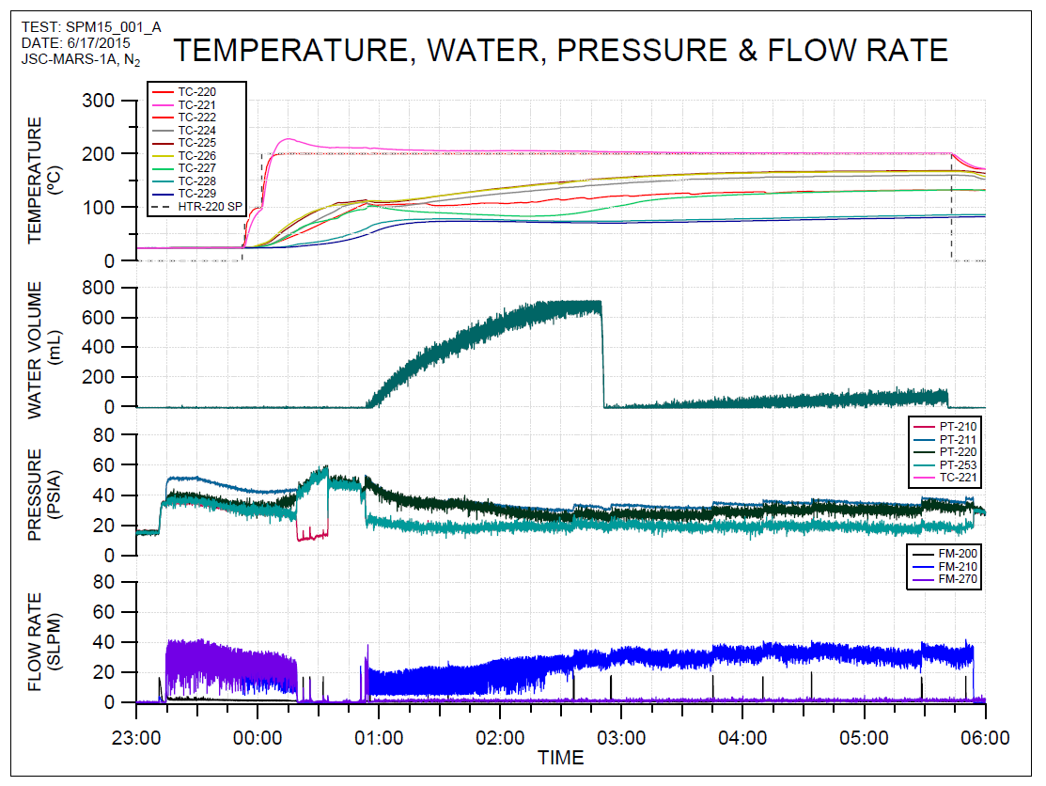
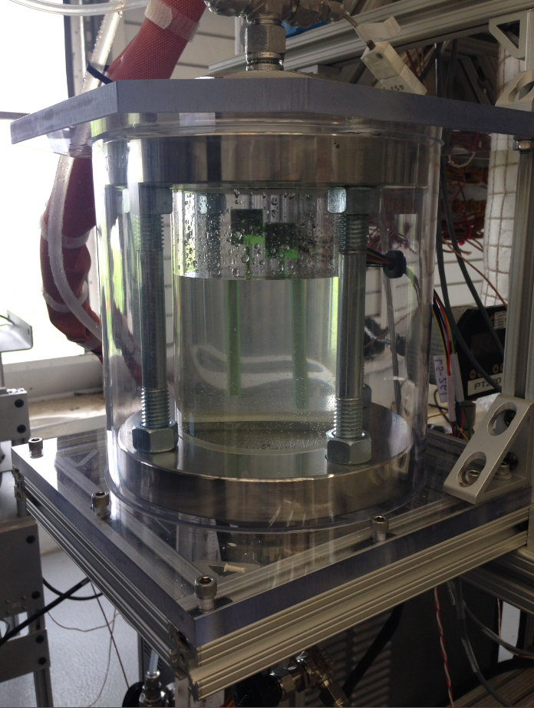
Hestia SPM Testing
WATER COLLECTOR
Line
Freeze
On Average: 19% Water by Weight, Most Evolves within 2-3 after Heater Turned On

Slide 12
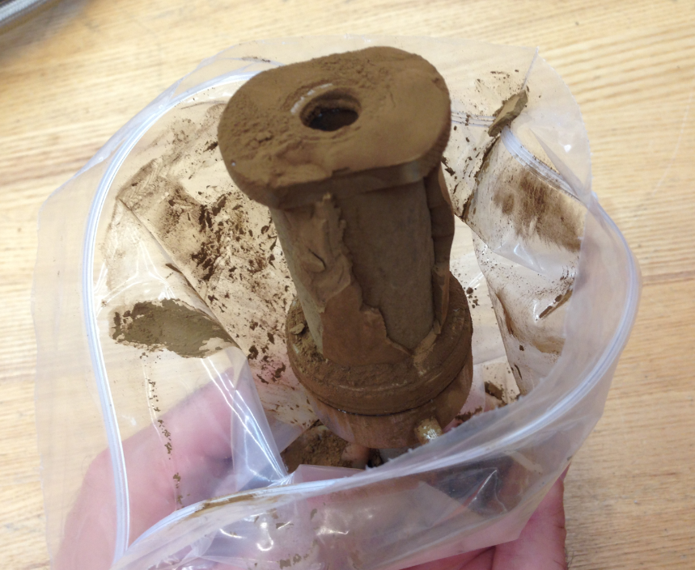
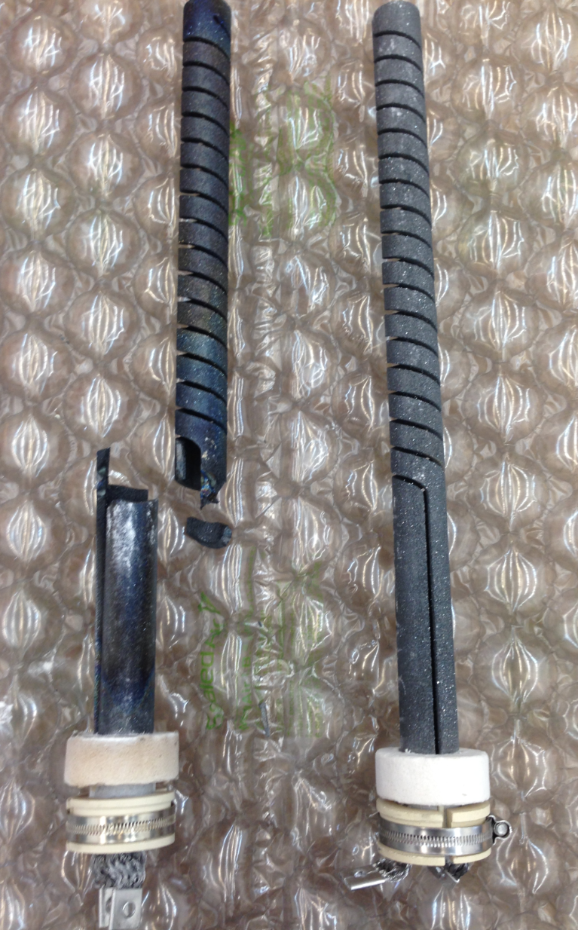
What Did We Learn?
Dryer Shape Matters
  Current Design: Flat Bottom
  Future Designs: Should be Conical
Regolith Egress Tube Size Matters
  Current Design: 1-1/4” OD Tube
  Future Designs: Larger ID
Heater Design Needs to be Robust
  Current Design: SiC Inside of a Heater Well
  Future Designs: Integrate into Vessel
Particulate Filtration is Challenging
  Current Design: 5 micron filter inside Sandman
  Addition: Downstream Borosilicate Glass Filter
  Future Designs: Capture Particulate inside the Vessel if Possible

Slide 13
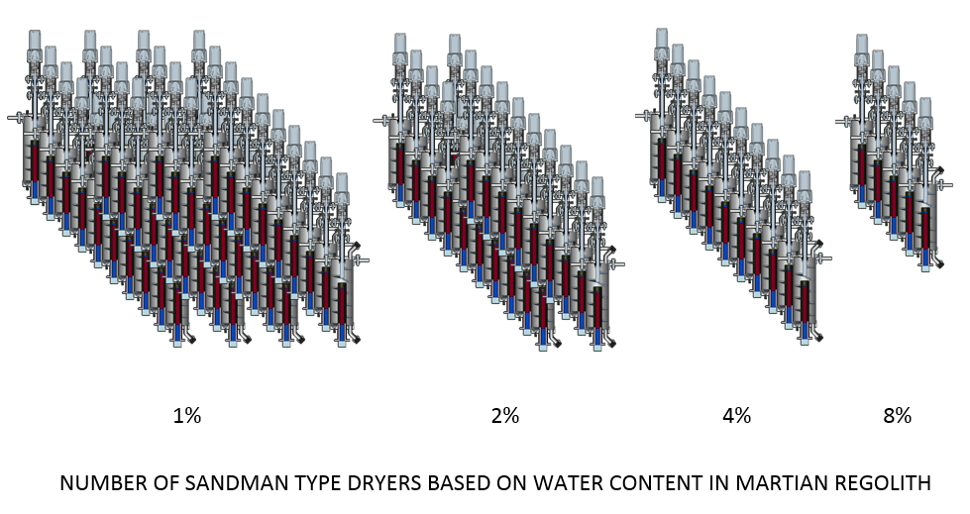
The Next Steps…
Improve Simulant
  JSC-Mars-1A has too much Water: 19% vs. 3-9% expected on Mars
  JSC-Mars-1A does not have Water bound in Hydrated Salts as expected on Mars
Develop More Flight Forward Design
  Simplify Fluid System
  Improve Condensing System
  Improve Dryer Design
    Incorporate Vacuum Compatible Components
    Improve Particulate Filtration
  Investigate Continuous Mode vs. Batch Mode
  Test Under Mars Conditions
Integrate with Other ISRU Hardware
  Water Cleanup
  Electrolysis
  Regolith Feed/Removal System

Slide 14
References
Anderson et Al,1979
Audouard et al. 2014 JGR
Barlow, Nadine G. Mars: An Introduction to Its Interior, Surface and Atmosphere. Cambridge, UK: Cambridge University Press, 2008.
Drake, B.G., “Human Exploration of Mars Design Reference Architecture 5.0, Executive Summary,” February 2009 (available from (available from http://ntrs.nasa.gov/archive/nasa/casi.ntrs.nasa.gov/20090012109.pdf).
Drake, B.G. (editor), “Human Exploration of Mars Design Reference Architecture 5.0,” NASA-SP-2009-566, July 2009
Smith et al 2009
Leshin et al, 2013
Mitrofnov et al, 2014
Milliken and Mustard et al, 2007a,b
United States Department of Agriculture, Sampling Surface and Subsurface Particle Size Distributions in Wadable Gravel- and Cobble-Bed Streams for Analyses in Sediment Transport, Hydraulics, and Streambed Monitoring (USDA Publication RMRS-GTR-74). 2001
Sanders, G. B., “In-Situ Resource Utilization on Mars – Update from DRA 5.0 Study,” AIAA 2010-799, January 2010.

Slide 15
Presentation notes
From Brian Banker

Slide 16
This is a test of the template system
Format
  Use this slide deck for template
  Time Limit 25 min:
    15 min talk
    10 min questions
  Picture Heavy
  Upload Files here by COB Friday, 29th
    https://oasis.jsc.nasa.gov/projects/HESTIA/EP/AIAA%20Houston%20Tech%20Symposium/Forms/AllItems.aspx

Slide 17
Flow
Where we fit into the Architecture
Background of Technology
  How long have we been working on it
  Why it (the technology)?
Where we are now
  What we’re doing at JSC
What’s Next for the technology

Slide 18
Title
Add Here
  Add here
    Add here
  Add here
    Add here
Add Here
  Add here
    Add here
  Add here
    Add here

